Slide 1
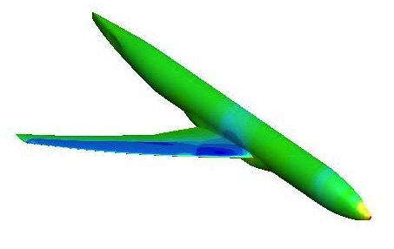
DPW 7 Summary of Participant Data
Edward N. Tinoco and the DPW Organizing Committee

Slide 2
Outline:
Introduction and Participant Data
Case 1: Grid Convergence Study
Case 2: Angle of Attack Sweep
Case 3: Reynolds Number Sweep
Case 4: Grid Adaptation
Case 5: Beyond RANS
Case 6: Coupled Aero-Structural Simulation
Observations/Issues

Slide 3
Should We Compare to Wind Tunnel?
Wind Tunnel | CFD
Walls | Free Air
Support System (Sting) | Free Air
Laminar/Turbulent (Tripped) | “Fully” Turbulent (usually)
Aeroelastic Deformation | Static Measured Deflections
Measurement Uncertainty | Numerical Uncertainty & Error
Corrections for known effects | No Corrections
Wind Tunnel and CFD measure/compute different things!
Neither produces free-air absolute values!
This CRM model
Tested in 3 different wind tunnels
Several repeats in each facility.
High degree of consistency among data – Excellent for increments
Data are included for reference

Slide 4
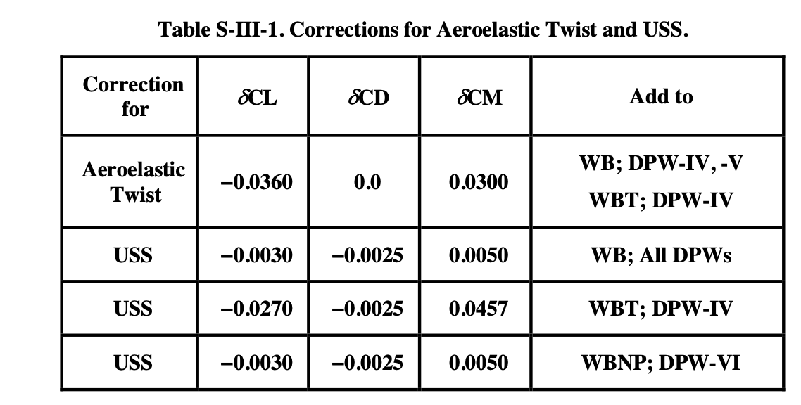
Question about mounting system corrections to CRM experimental data
Source
Refs. 1&2
Ref. 3
Refs. 1&2
Ref. 3
Rivers, M. and Hunter, C., “Support System Effects on the NASA Common Research Model,” AIAA Paper 2012-707, January 2012.
Rivers, M., Hunter, C., and Campbell, R., “Further Investigation of the Support System Effects and Wing Twist on the NASA Common Research Model,” AIAA Paper 2012-3209, June 2012.
Tinoco, Edward N., “An Evaluation and Recommendations for Further CFD Research Based on the NASA Common Research Model (CRM) Analysis from the AIAA Drag Prediction Workshop (DPW) Series,” NASA/CR-2019-220284

Slide 5
CRM geometry for DPW7 includes the static aeroelastic twist and deformation experienced by the model at different angles of attack
~ CL=0.50
“as-built”
Aeroelastic

Slide 6
SSG/LRR-ln-omega
SSG/LRR-ln-omega
SSG/LRR-ln-omega
SSG/LRR-ln-omega
Participant Data:
30 Total Data Submittals
18 Teams/Organizations
6 N. America, 7 Europe, 4 Asia
7 Government, 2 Industry, 1 Academia, 5 Commercial
2 for Case 5 only, 1 for Case 6 only
Grid Types:
16 Unstructured (x Teams)
3 Overset (x Teams)
3 Structured Multi-block ( x Teams)
1 Custom Cartesian (x Teams)
Turbulence Models:
14 SA-QCR (all types), 7 SA w/oQCR, 4 SST, 2 EARSM,
1 SSG/LRR, 1 AMM-QCR, 1 RSM-ln(w)

Slide 8
Outline:
Participant Data
Case 1: Grid Convergence Study
Case 2: Angle of Attack Sweep
Case 3: Reynolds Number Sweep
Case 4: Grid Adaptation
Case 5: Beyond RANS
Case 6: Coupled Aero-Structural Simulation
Observations/Issues

Slide 9
Case 1: Grid Convergence Study
Grid Convergence Study
NASA Common Research Model -
Mach=0.85, C_{L}=0.580±0.001
Chord Reynolds Number: 20x10⁶ , 5x10⁶ Optional
Grid Resolution Level:
1) Tiny 2) Coarse 3) Medium,
4) Fine 5) Extra-Fine 6) Super-Fine
Reynolds Number Effect on Forces and Moments

Slide 10
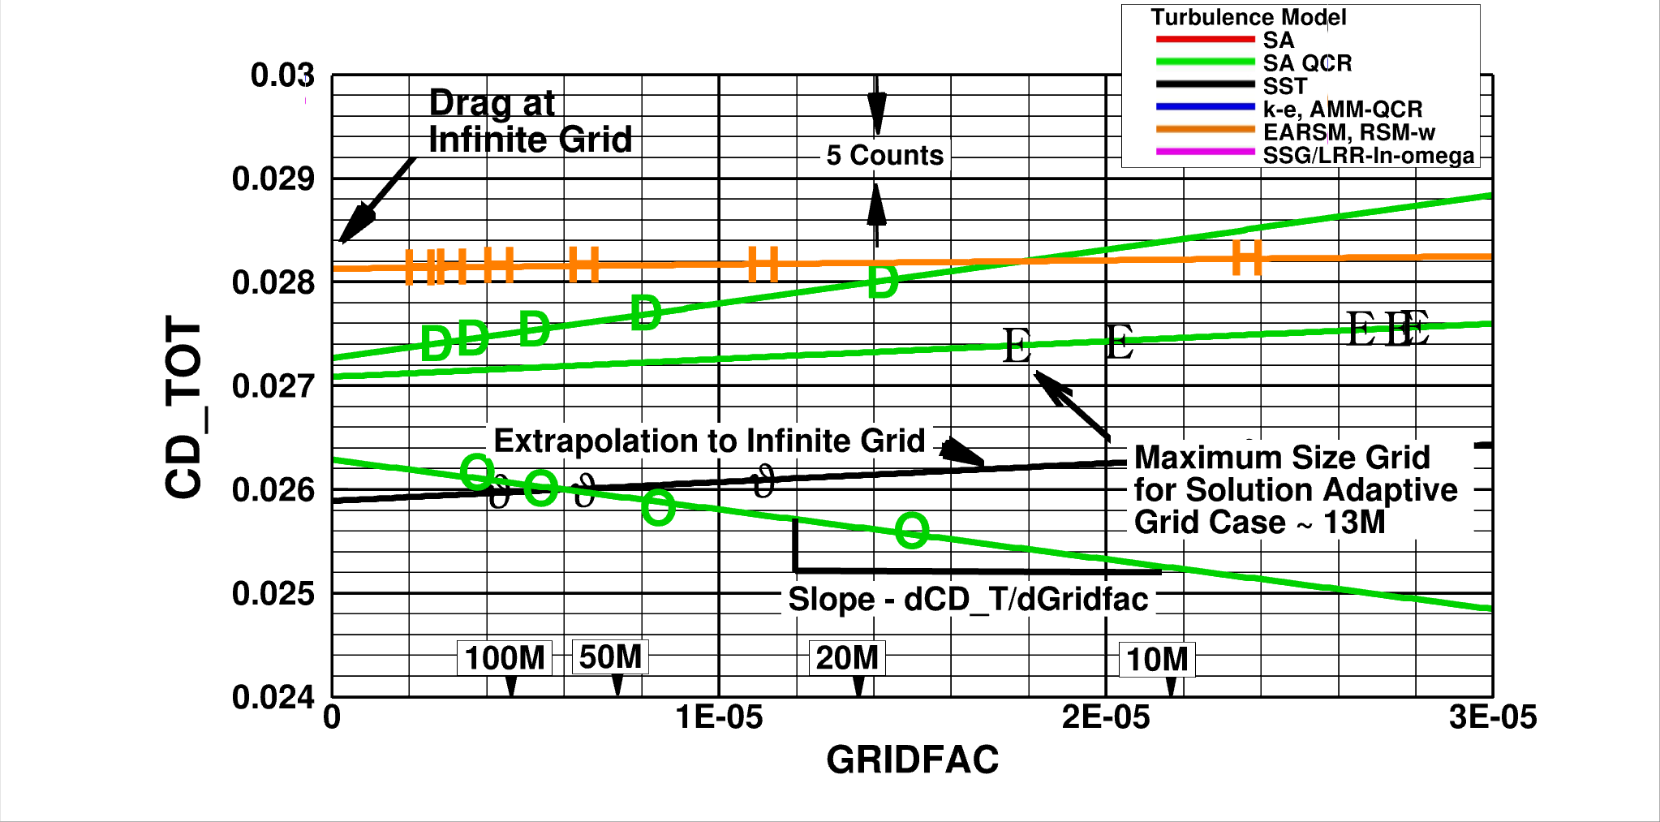
Grid Convergence?
Richardson Extrapolation:
Standard 2nd order least squares fit
For 2nd order codes, should be linear vs. Grid_Factor = N^{-2/3}
Y-intercept estimates theoretical infinite resolution (continuum) result

Slide 11
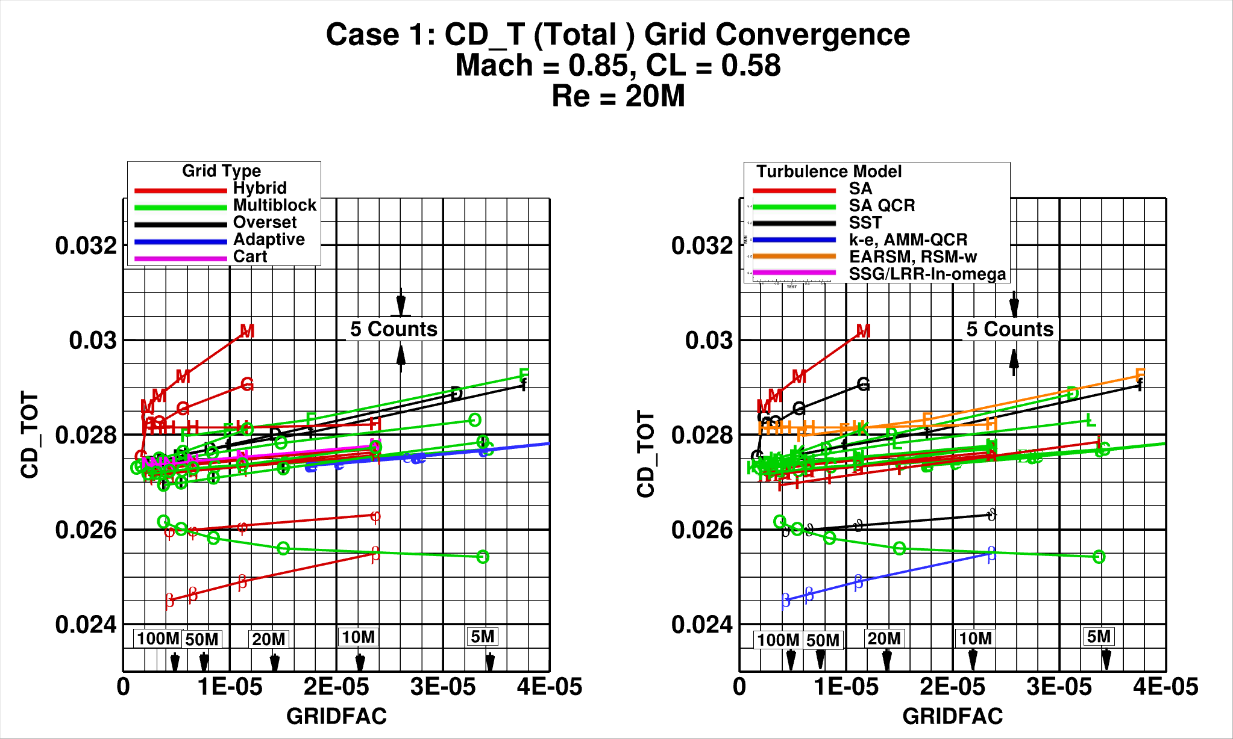

Slide 12
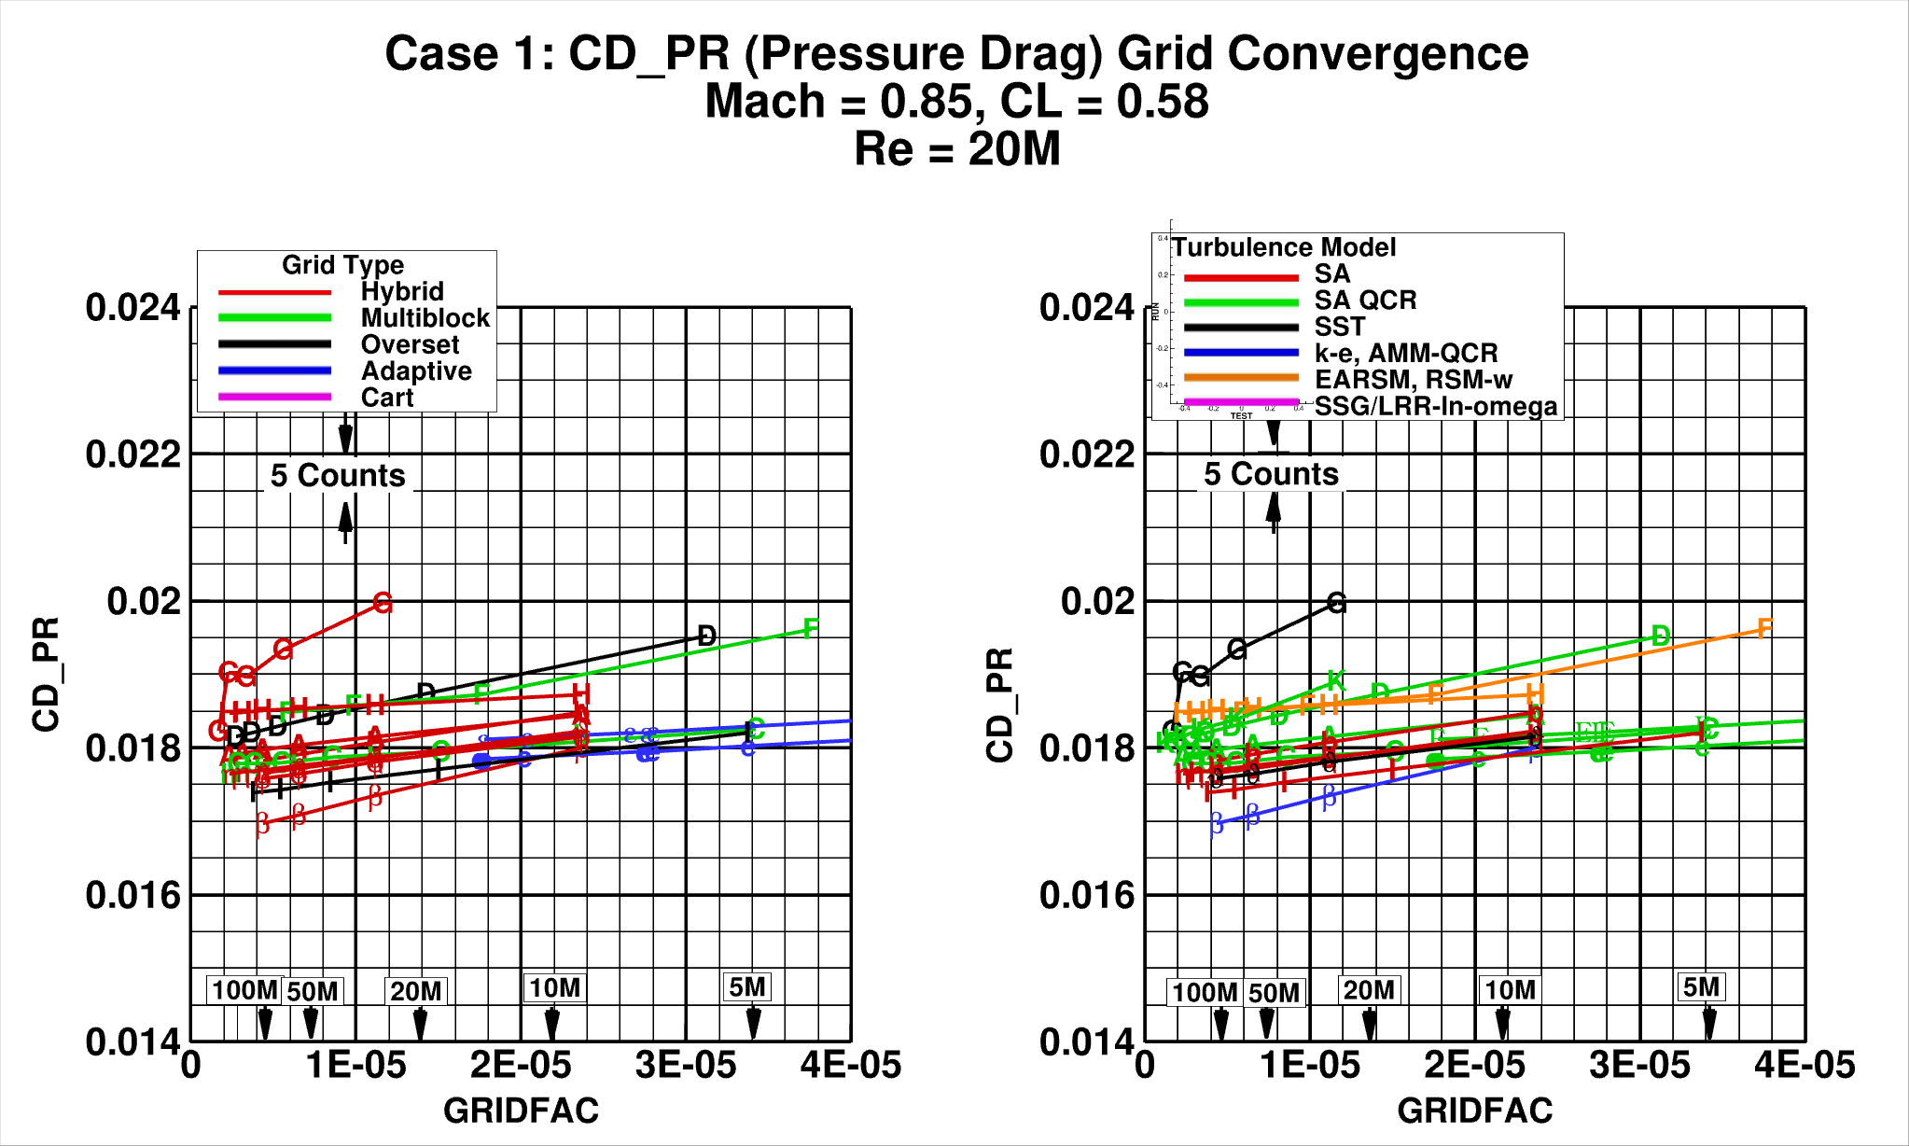

Slide 13
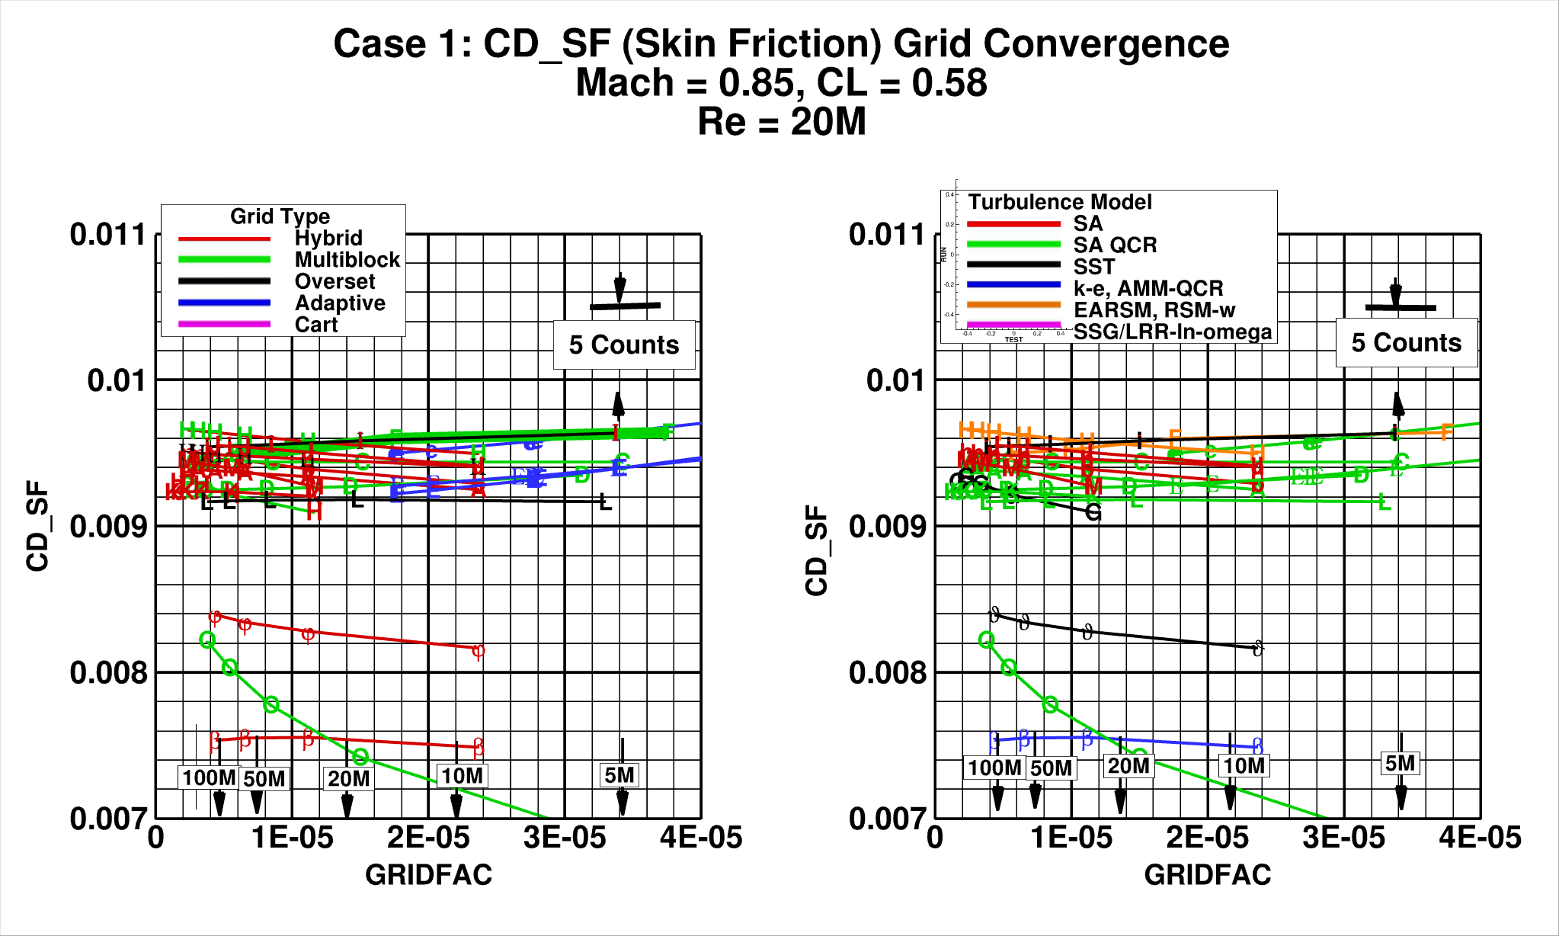

Slide 14
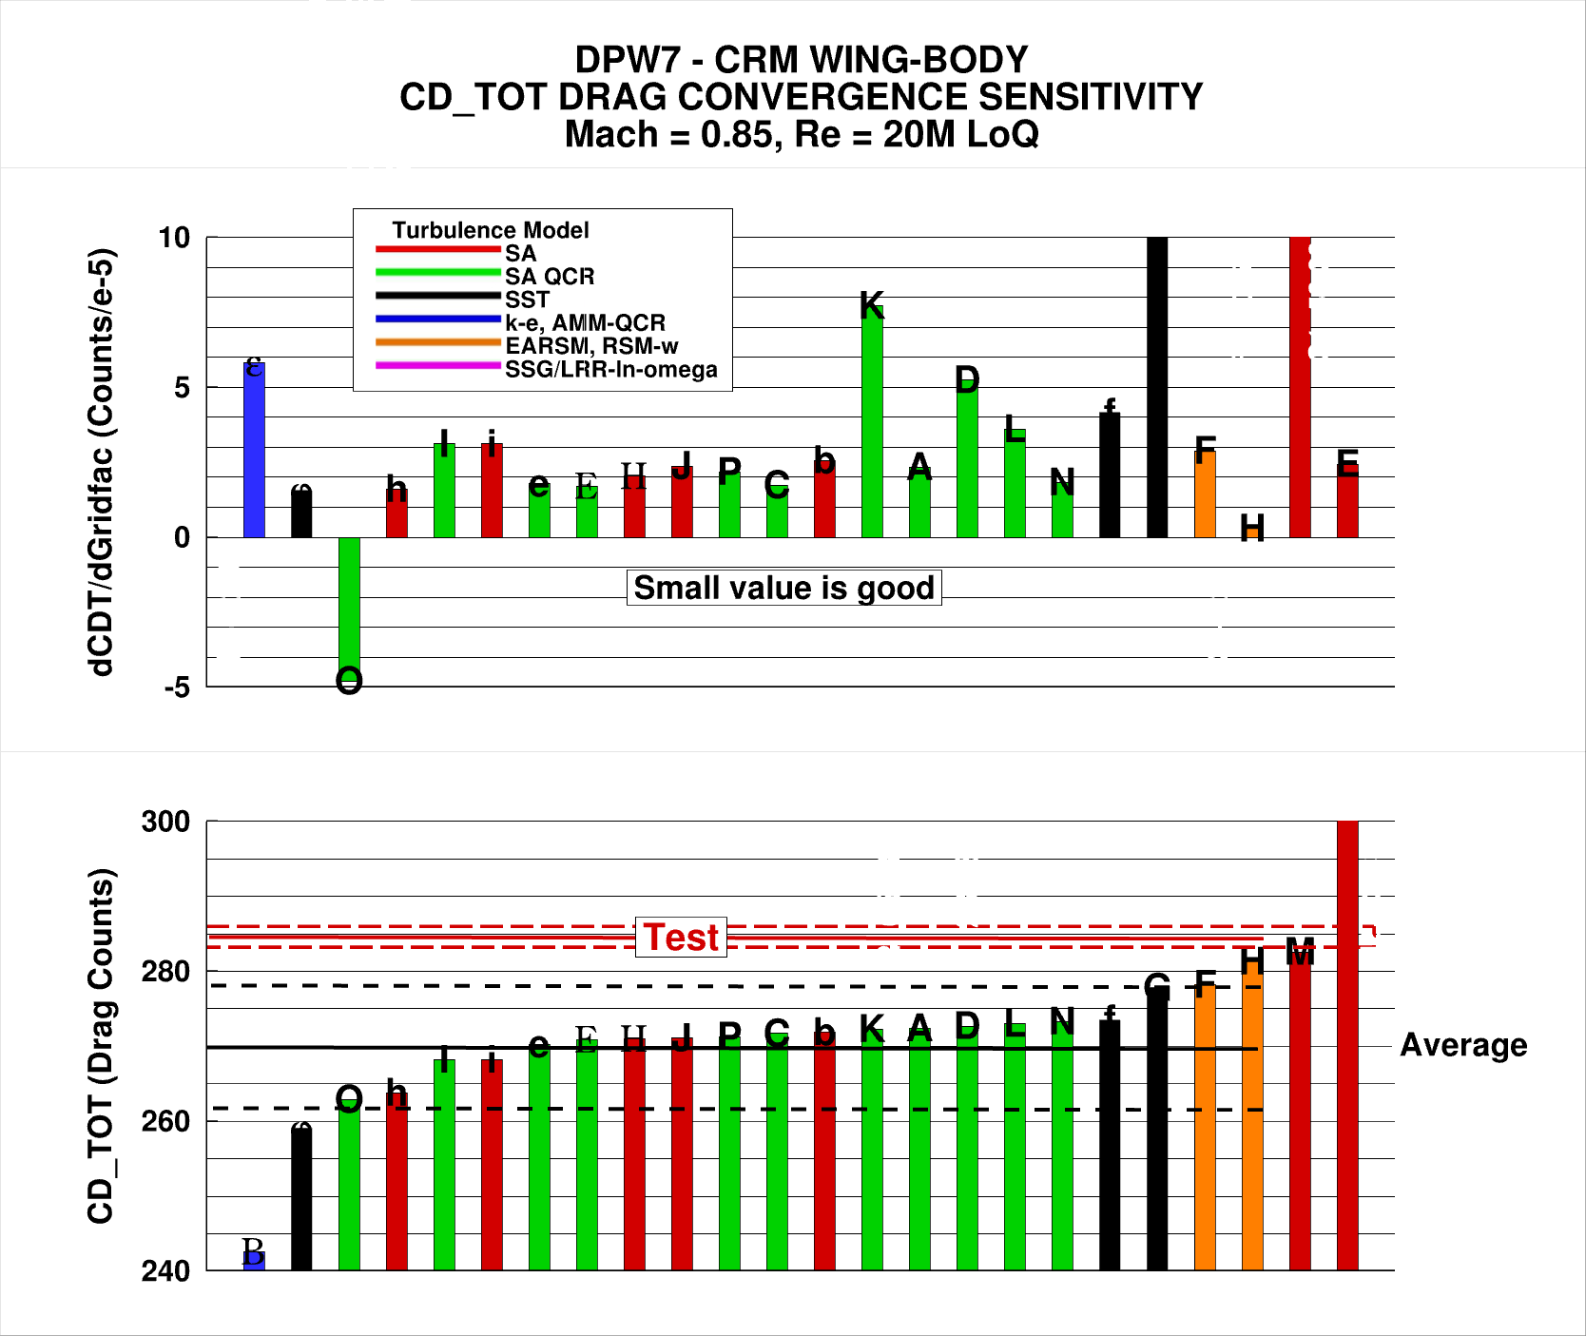
285 +/- 2 counts
270 +/- 8 counts

Slide 15
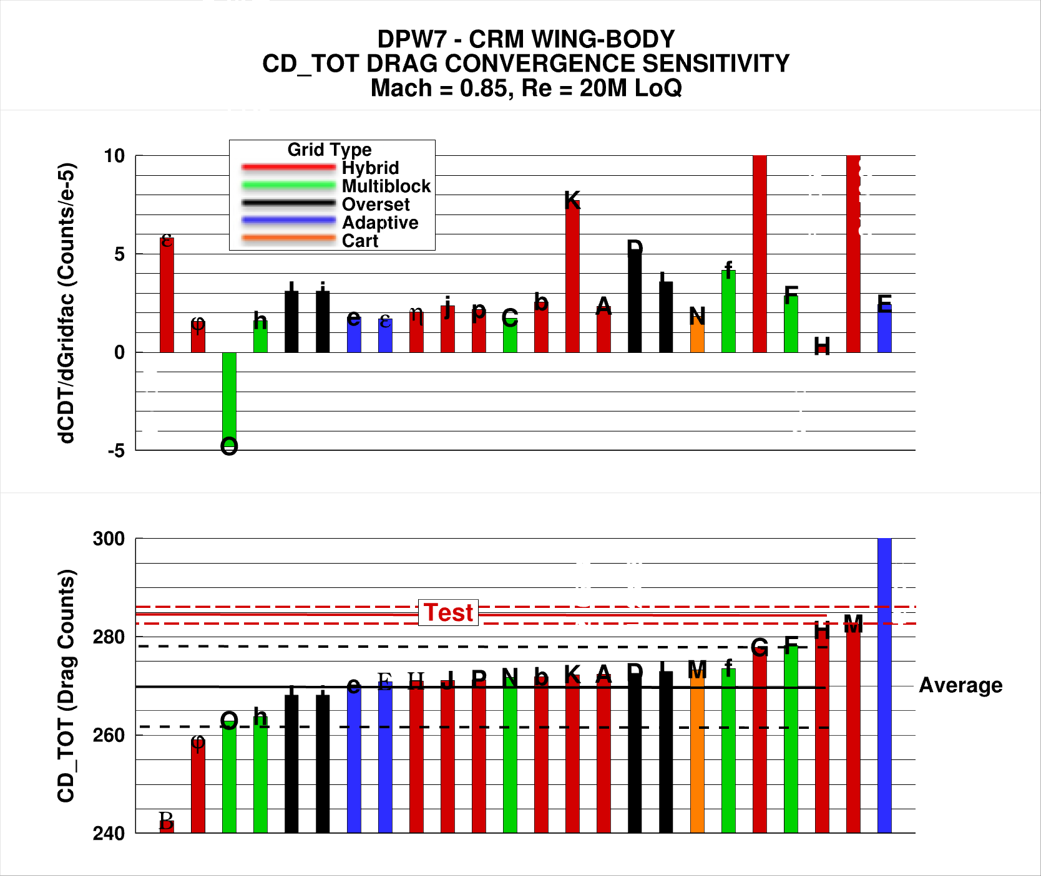
285 +/- 2 counts
270 +/- 8 counts

Slide 16
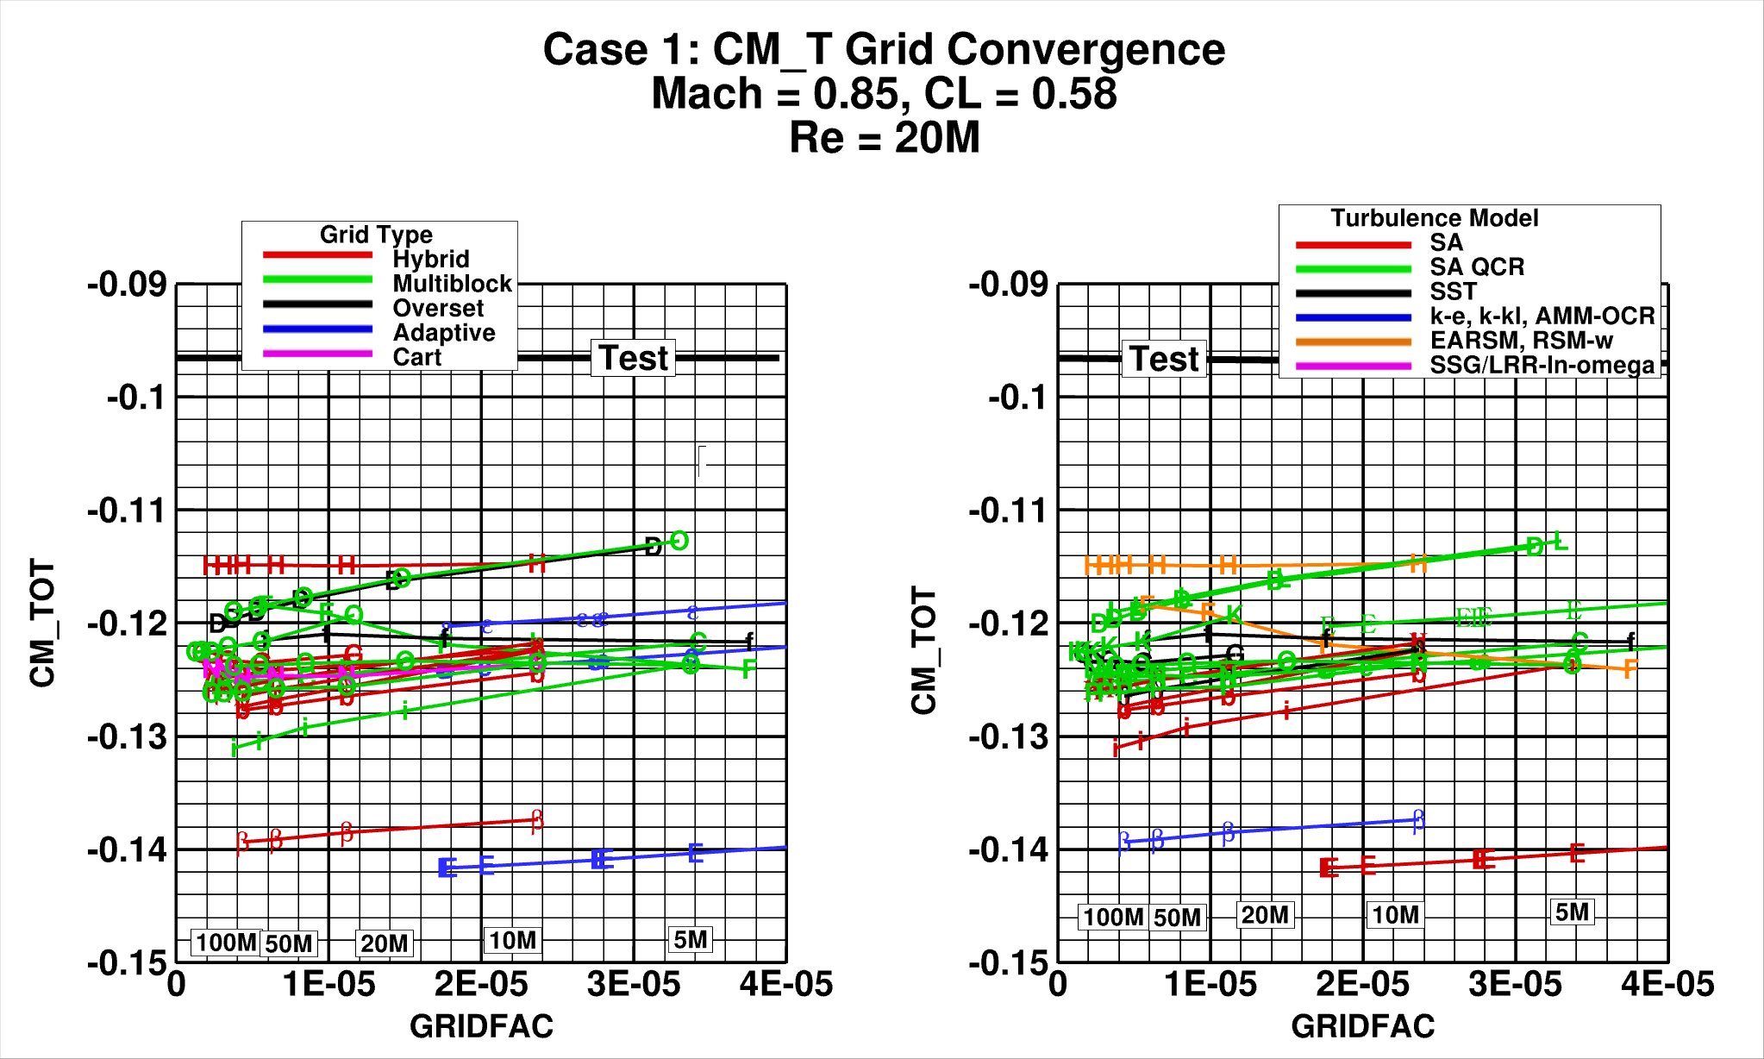

Slide 17
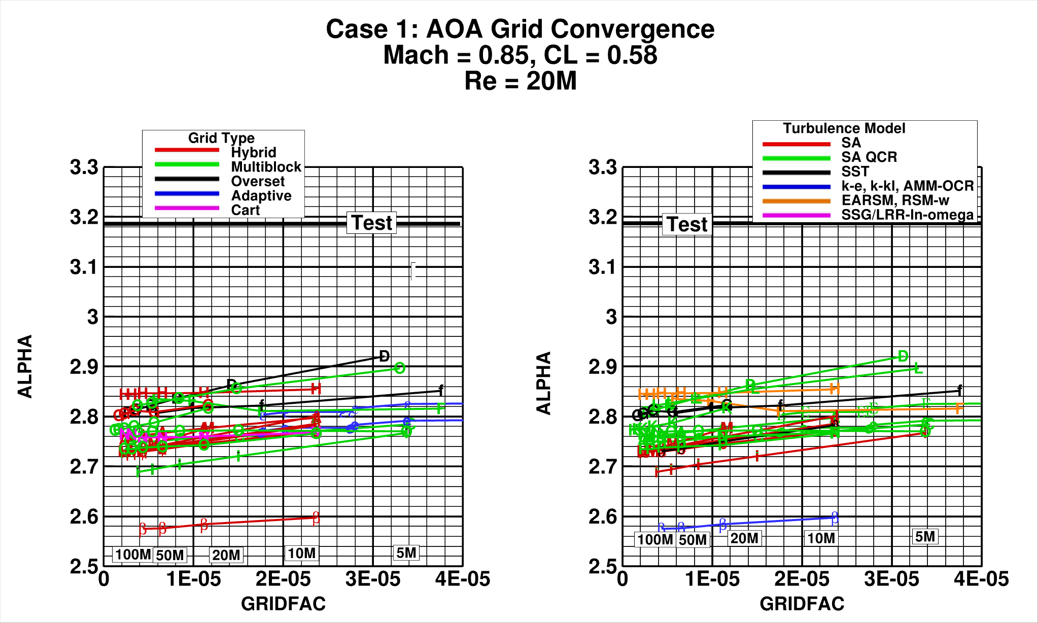

Slide 18
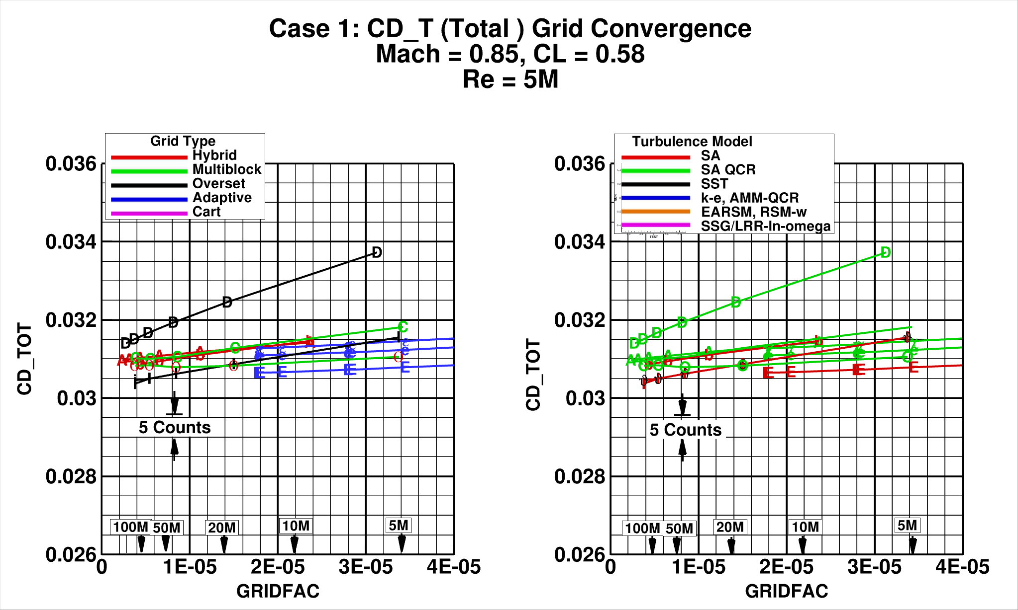

Slide 19
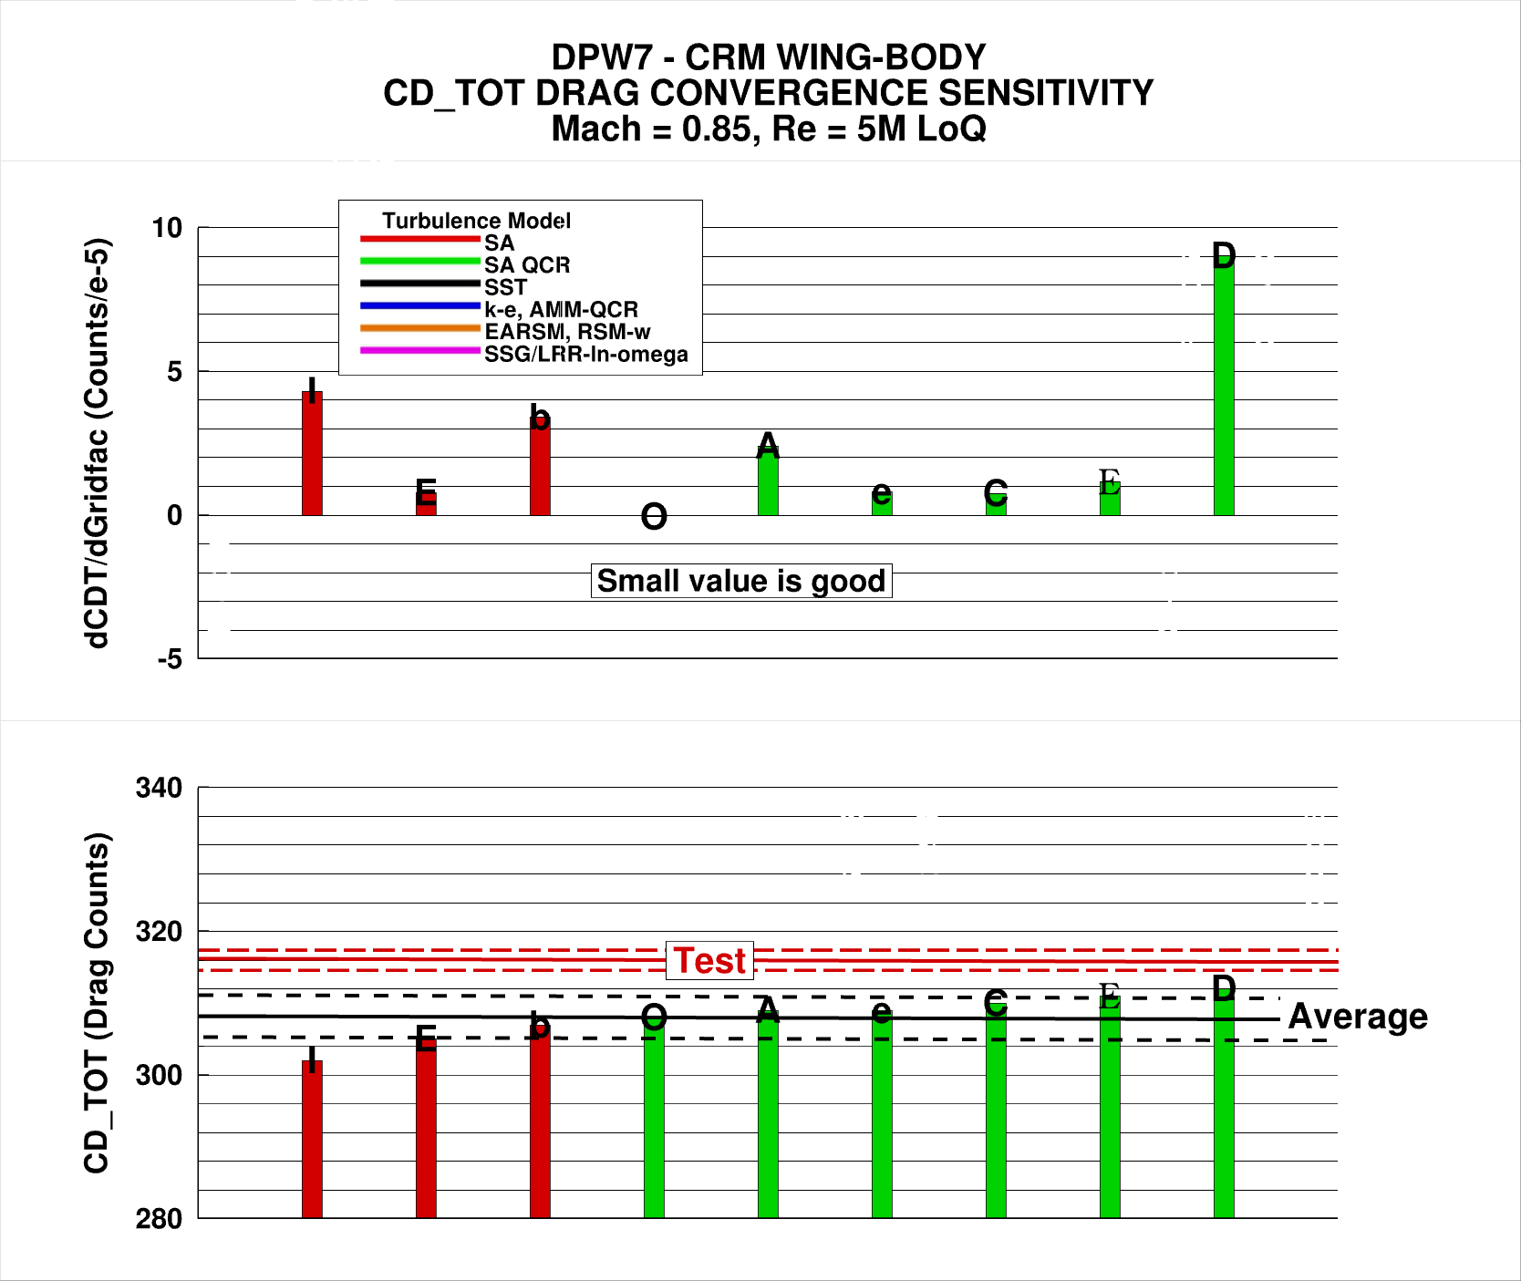
316 +/-1.5 counts
308 +/- 3 counts

Slide 20
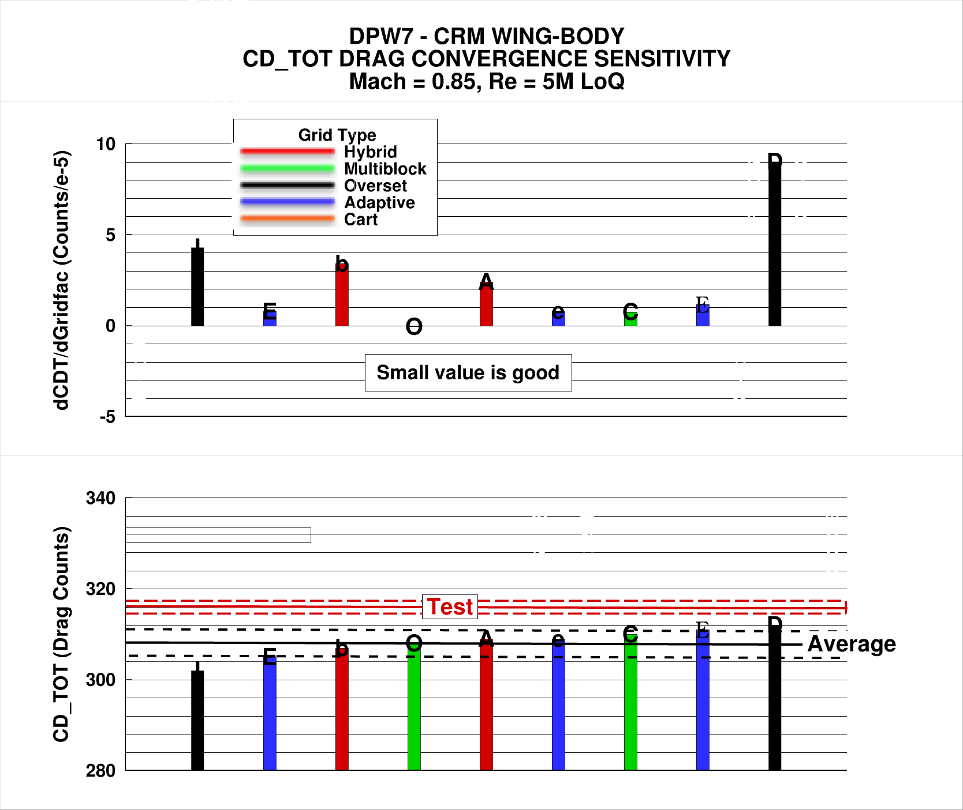
316 +/-1.5 counts
308 +/- 3 counts

Slide 21
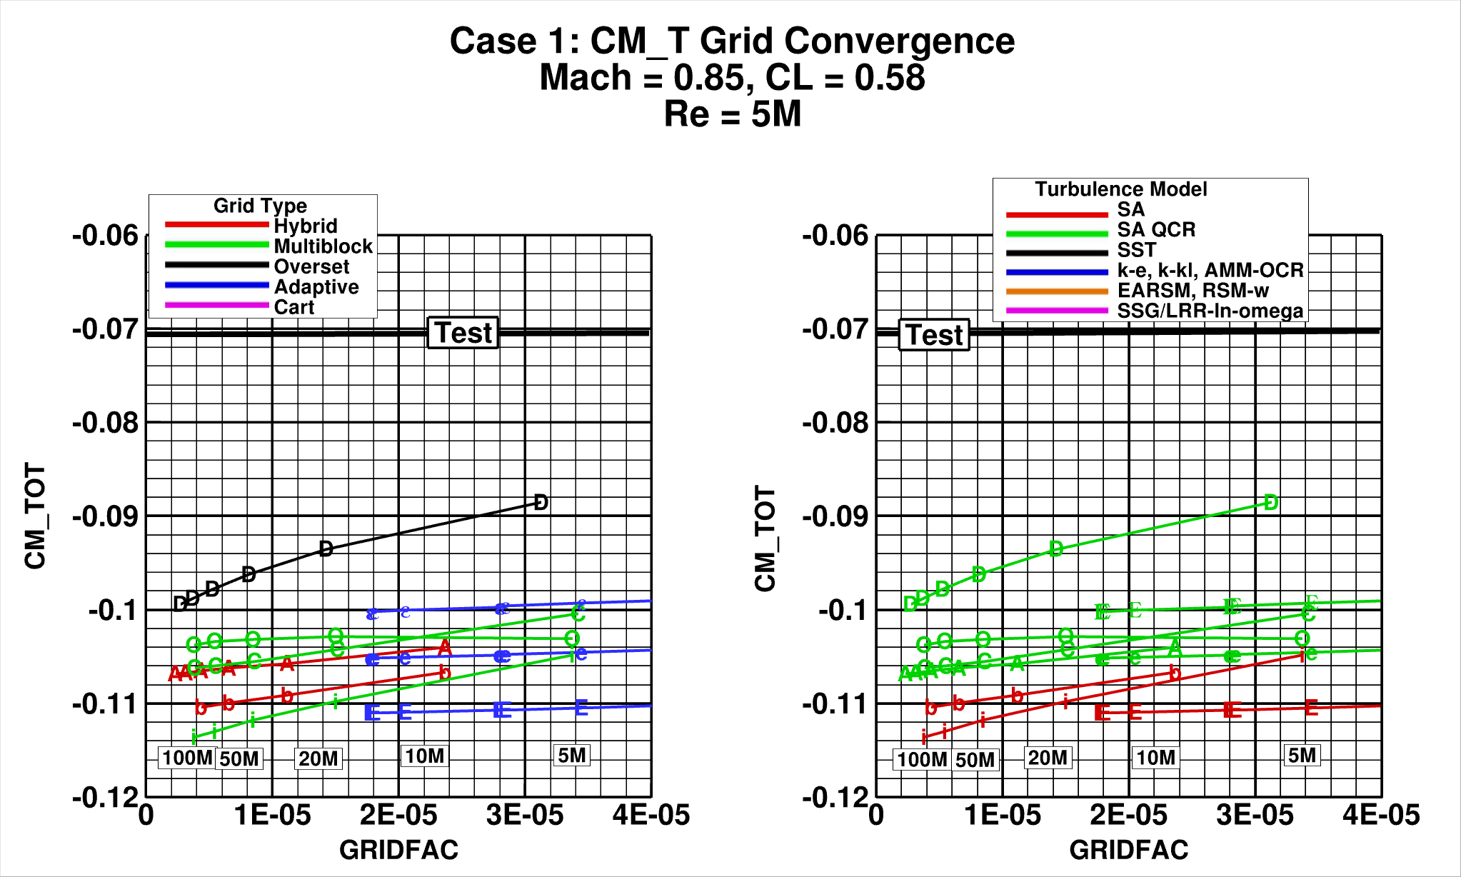

Slide 22
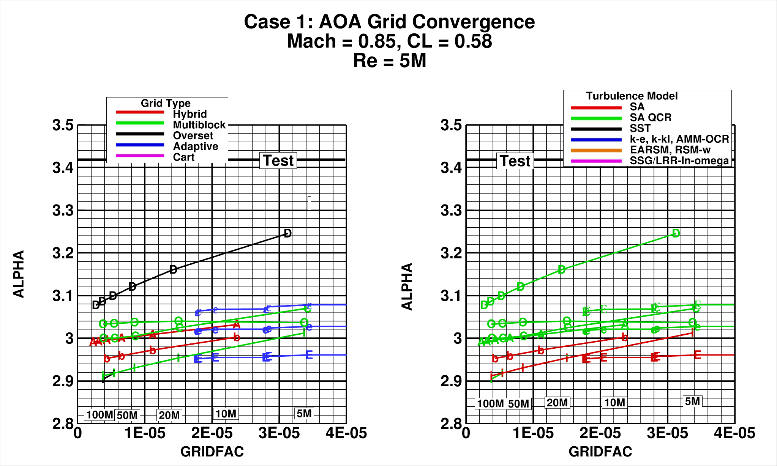

Slide 23
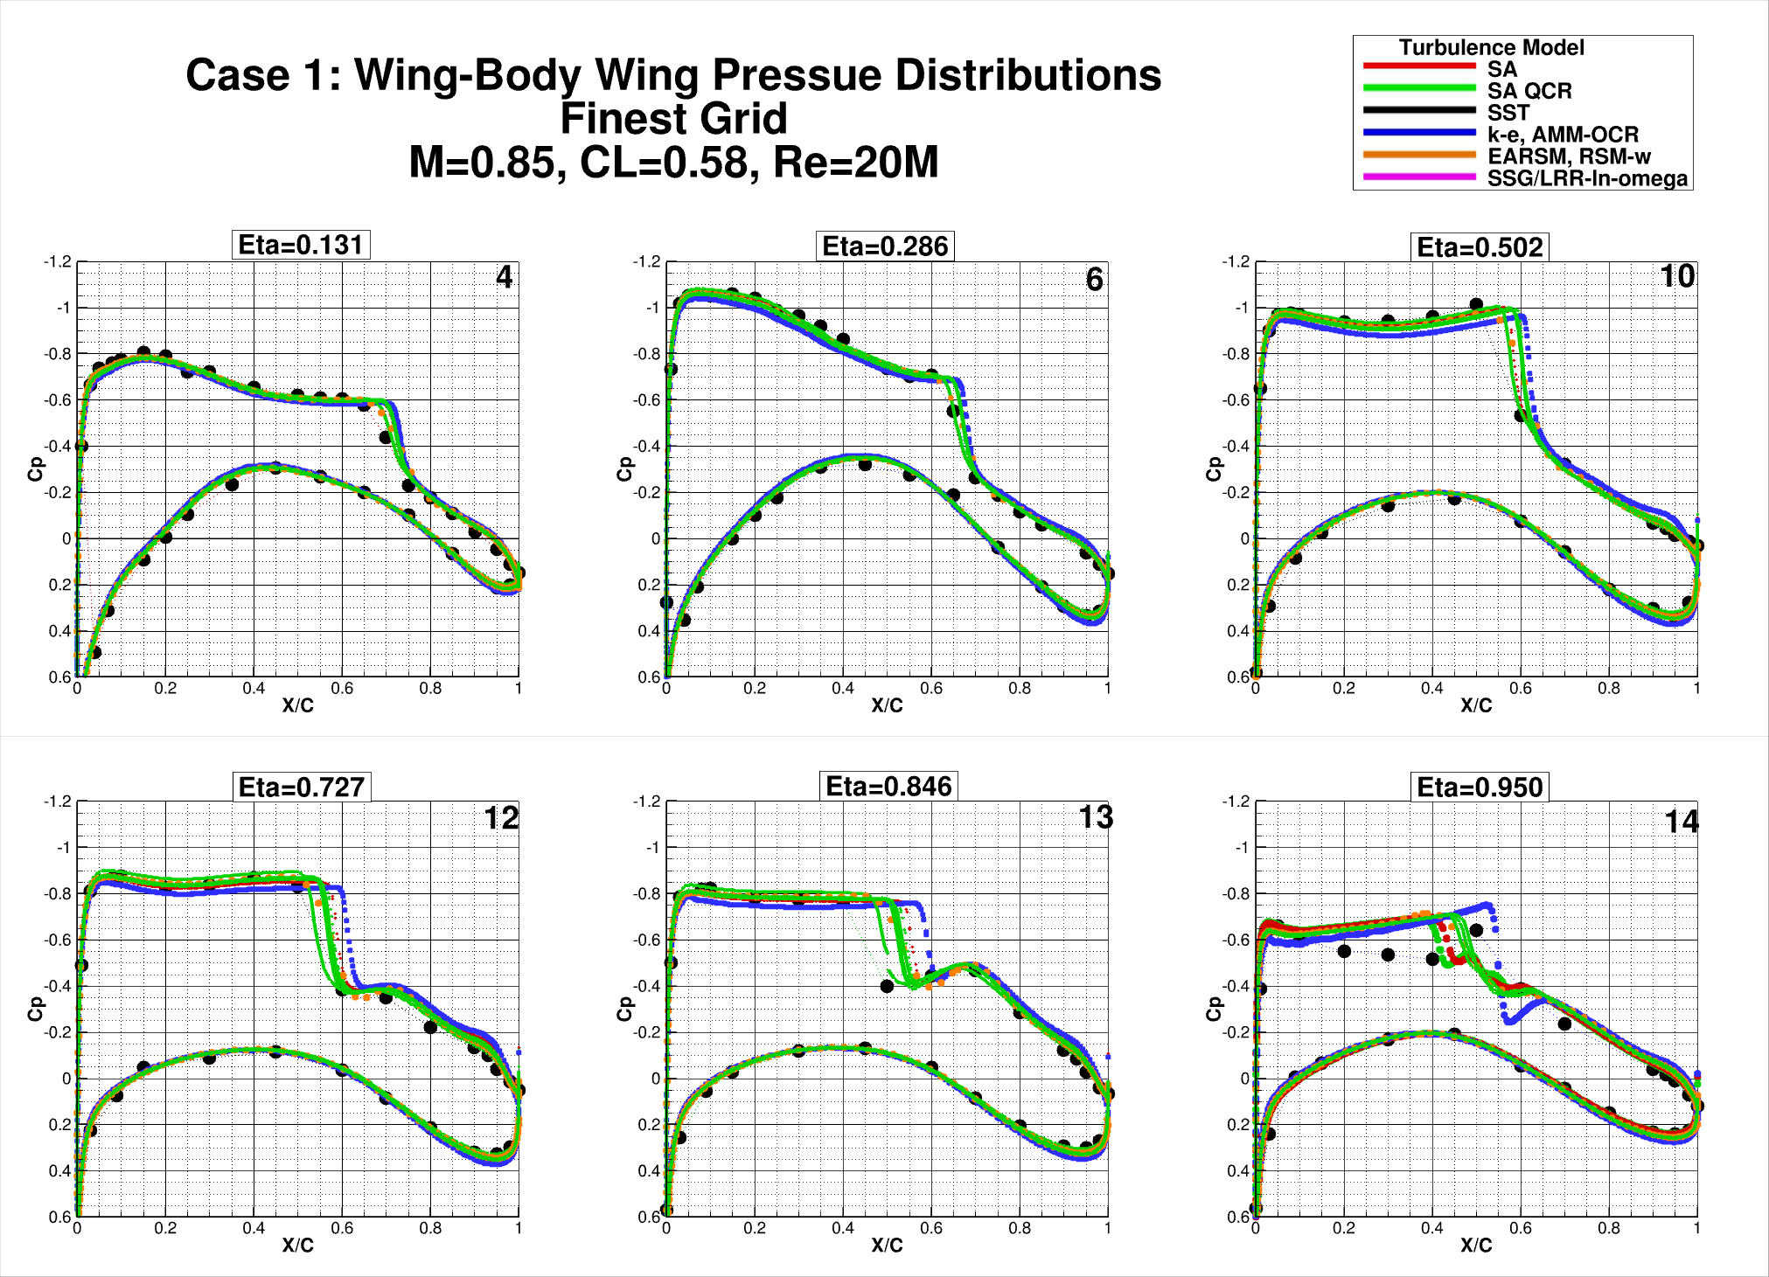

Slide 24
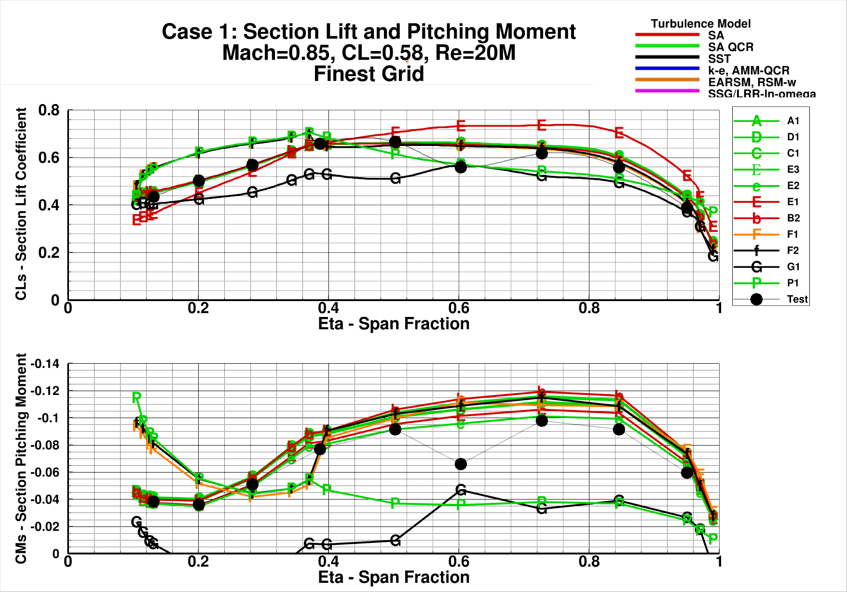

Slide 25
Case 1 - Observations
With very few exceptions solutions showed very good linear Richardson extrapolation.
No clear break-outs with grid type or turbulence model AT THIS (ATTACHED FLOW) CONDITION!
Excessive aft-loading on outboard wing sections contributes to too negative section pitching moments and excessive section lift (see Case 2).

Slide 26
Outline:
Participant Data
Case 1: Grid Convergence Study
Case 2: Angle of Attack Sweep
Case 3: Reynolds Number Sweep
Case 4: Grid Adaptation
Case 5: Beyond RANS
Case 6: Coupled Aero-Structural Simulation
Observations/Issues

Slide 27
Case 2: Angle of Attack Sweep
NASA Common Research Model, Wing-Body
Mach=0.85:
α=2.75 °, 3.00 °, 3.25 °, 3.50 °, 3.75 °, 4.00 °, 4.25°,
Grid Resolution Level:
3) Medium,
Chord Reynolds Number: 20x10⁶ , 5x10⁶ Optional
Measured Static Aero-Elastic Wing Deformation at each angle of attack

Slide 28
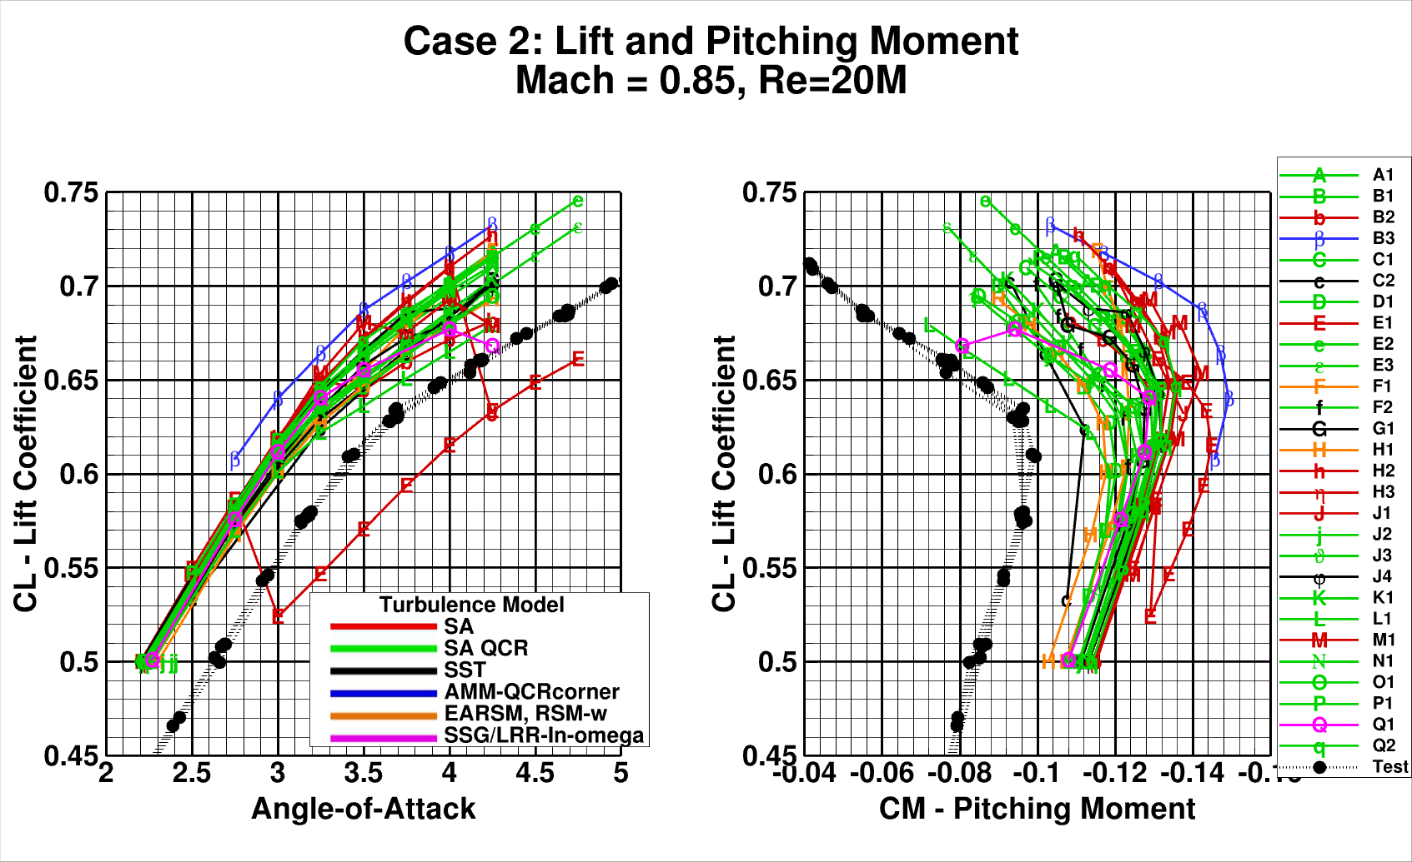

Slide 29
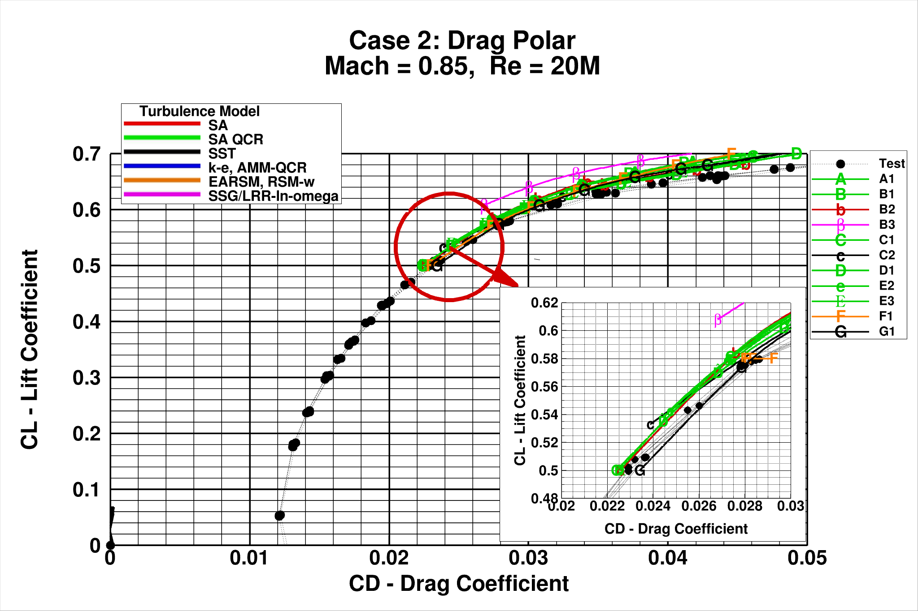

Slide 30
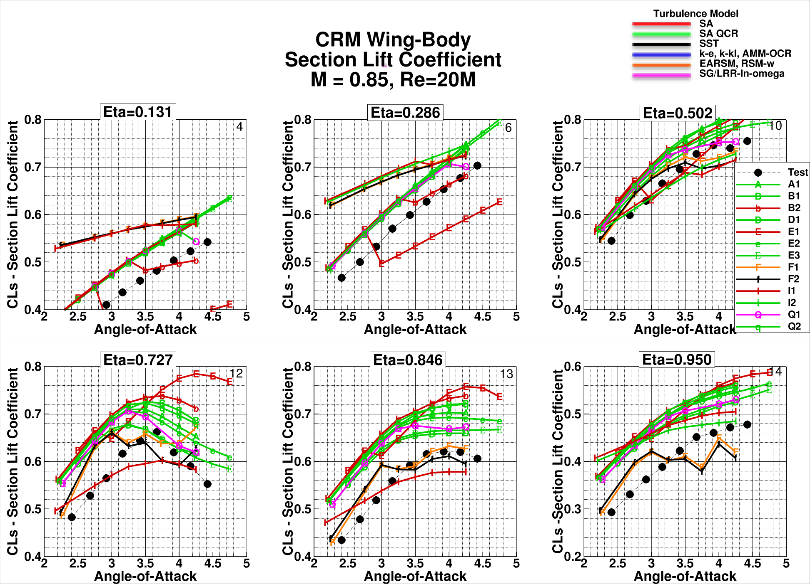

Slide 31
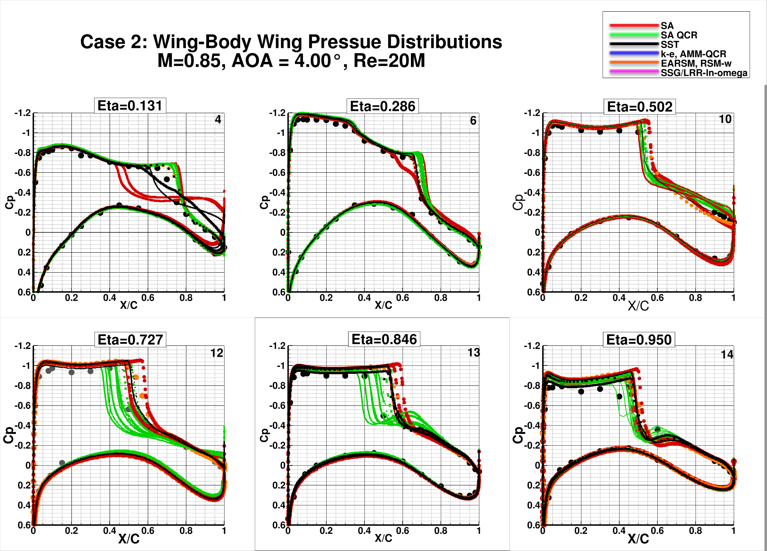

Slide 32
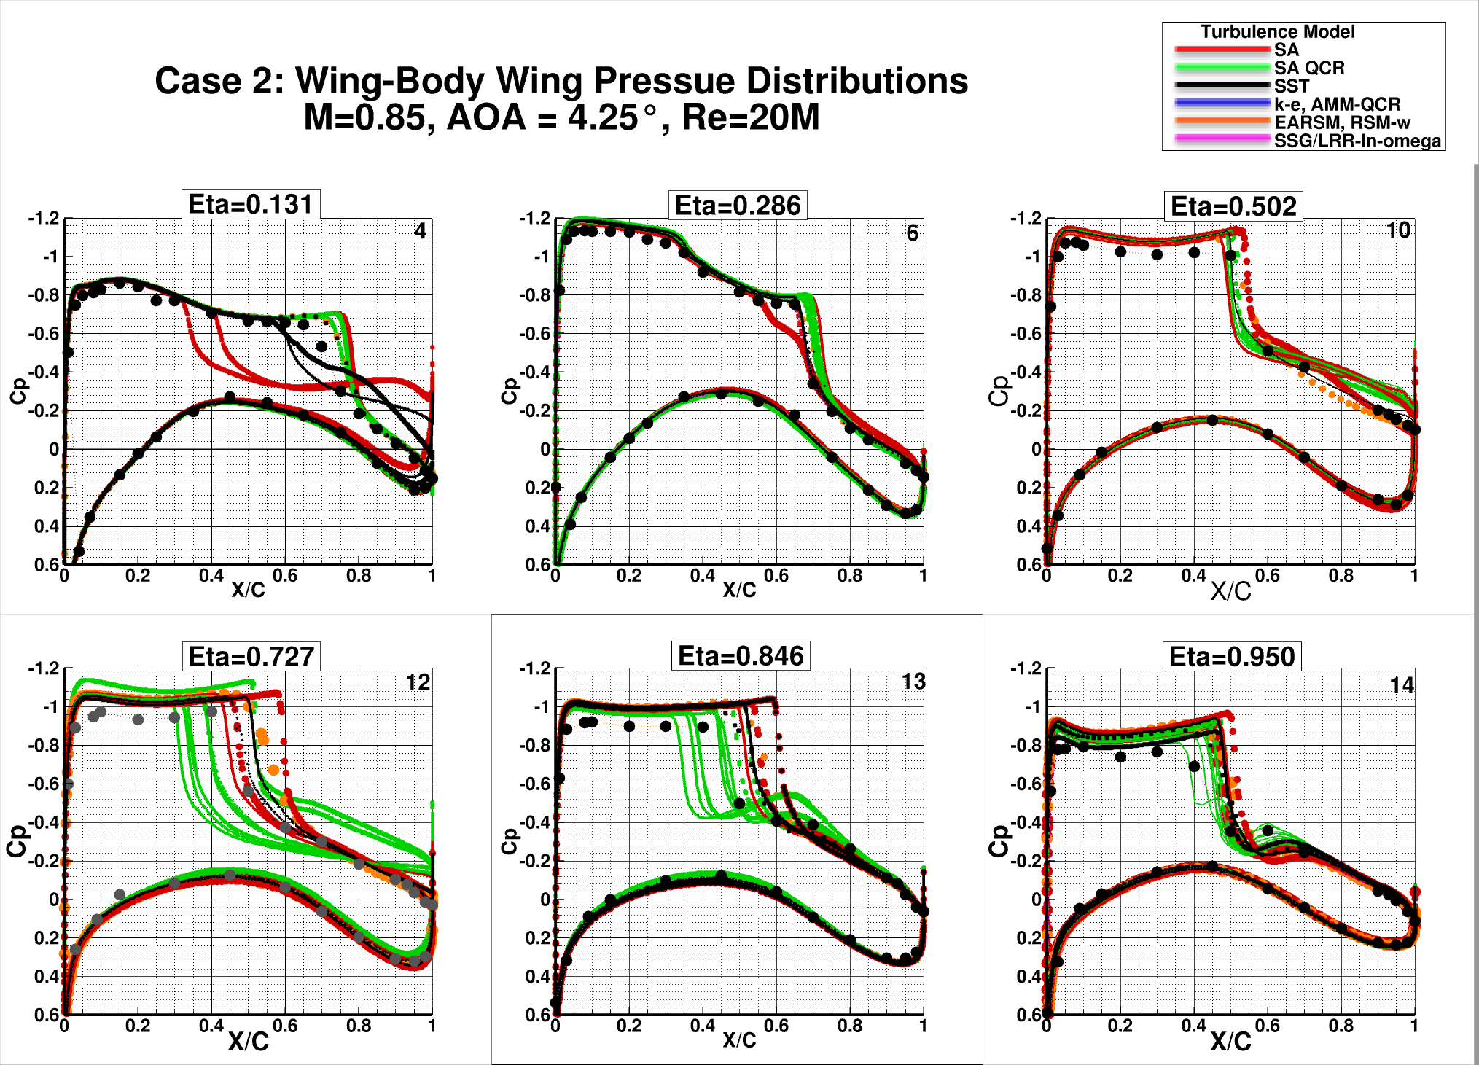

Slide 33
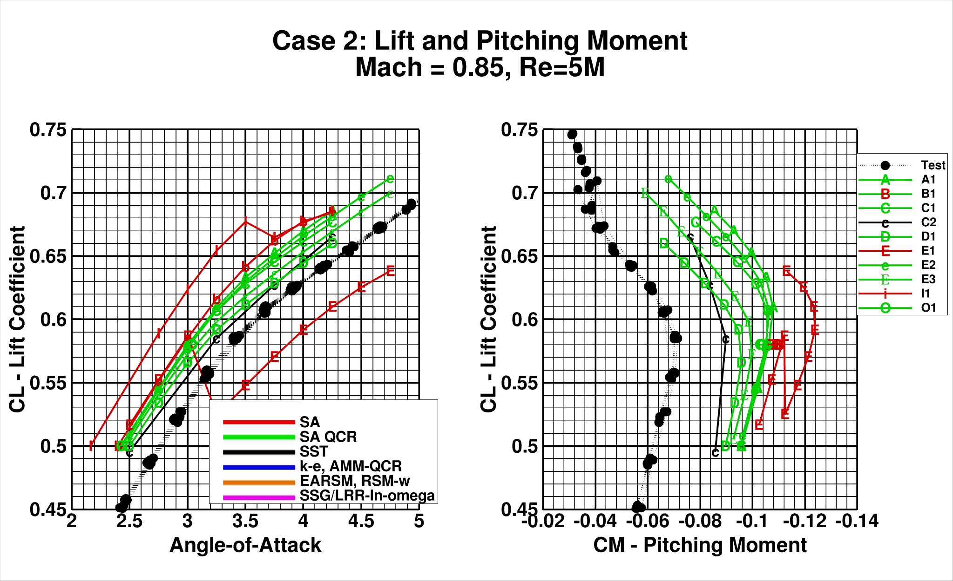

Slide 34
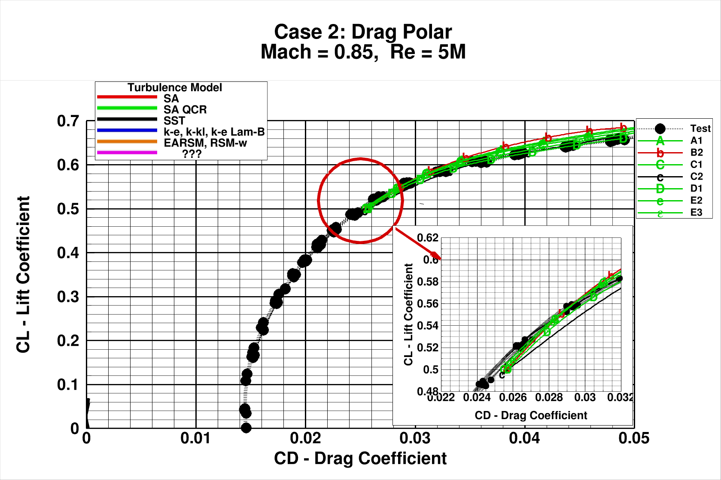

Slide 35
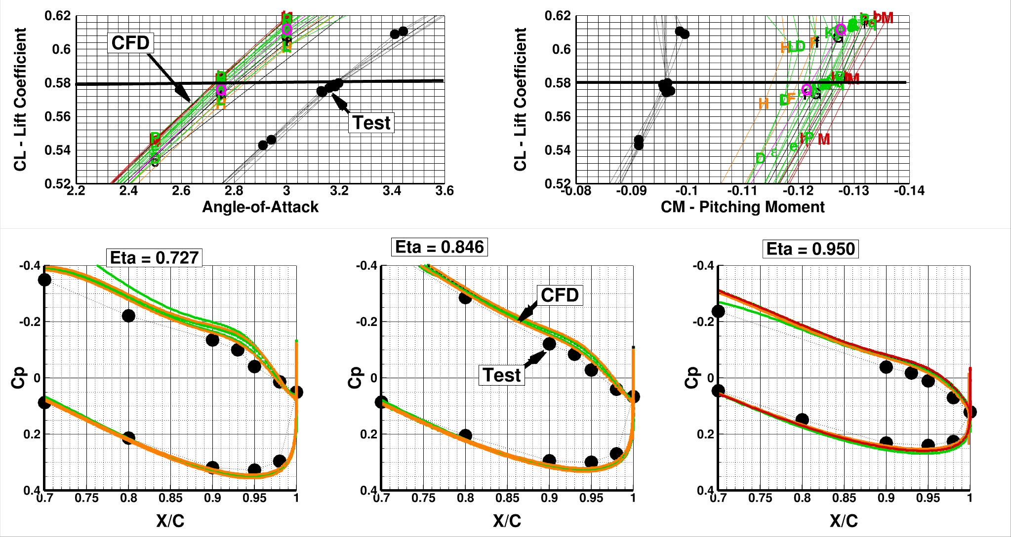
Excessive “Aft-Loading” results in higher lift and more negative pitching moment (common in all solutions)
Mounting system correction is too small to account for difference
Paper by Curtin, M.M, Bogue, D.R., Om D., Rivers, S.M.B., Pendergraft, O.C., and Wahls, R. A., “Investigation of Transonic Reynolds Number Scaling on a Twin-Engine Transport (Invited),” AIAA-2002-0420, January 2002. suggested that excessive CFD “aft-loading” goes away with increasing Reynolds number

Slide 36
Collapsing CFD to a Common Value of α and C_{M}
CFD and WT are better at predicting increments than absolutes.
Collapse CFD results to pass through a common point by adding a Δ angle-of-attack (Δα) and Δ pitching moment (ΔC_{M}) to each solution.
Clear view of C_{L} and C_{M} variation with α variation
Δα
ΔC_{M}
Notes:
CFD & WT better at increments than absolutes
@-Our approach it to collapse CFD to common α and CM
.. clear view of variation of CL and CM with angle of attack compared to the test data.
.

Slide 37
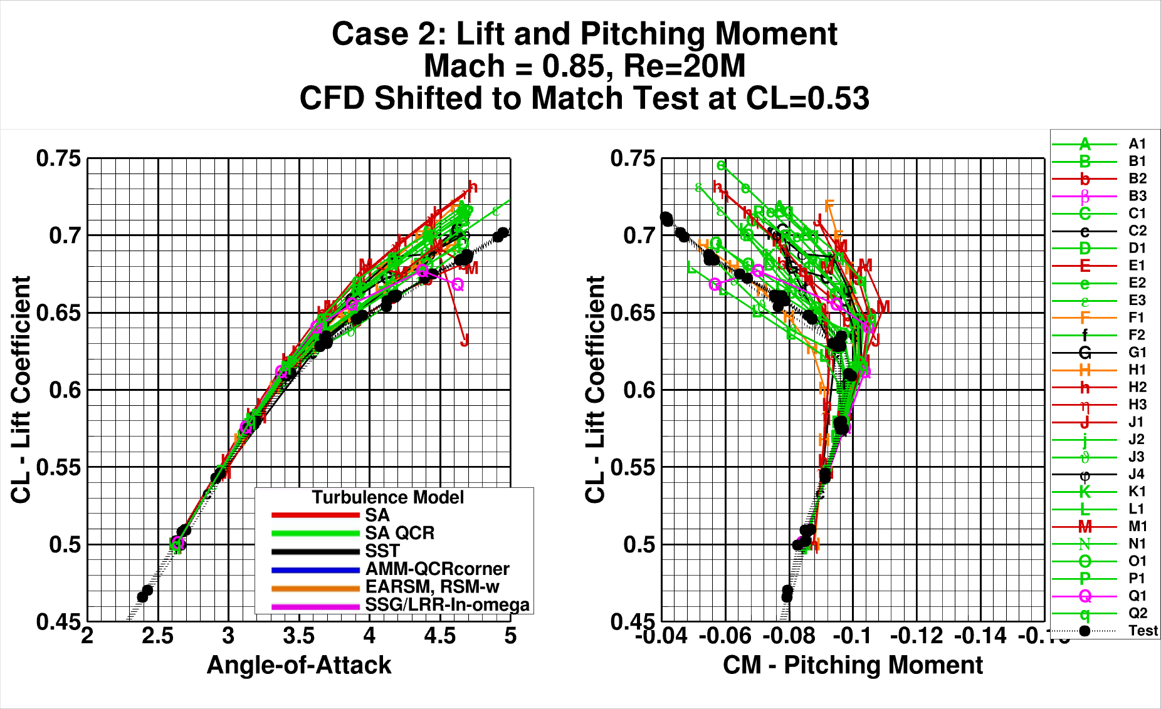

Slide 38
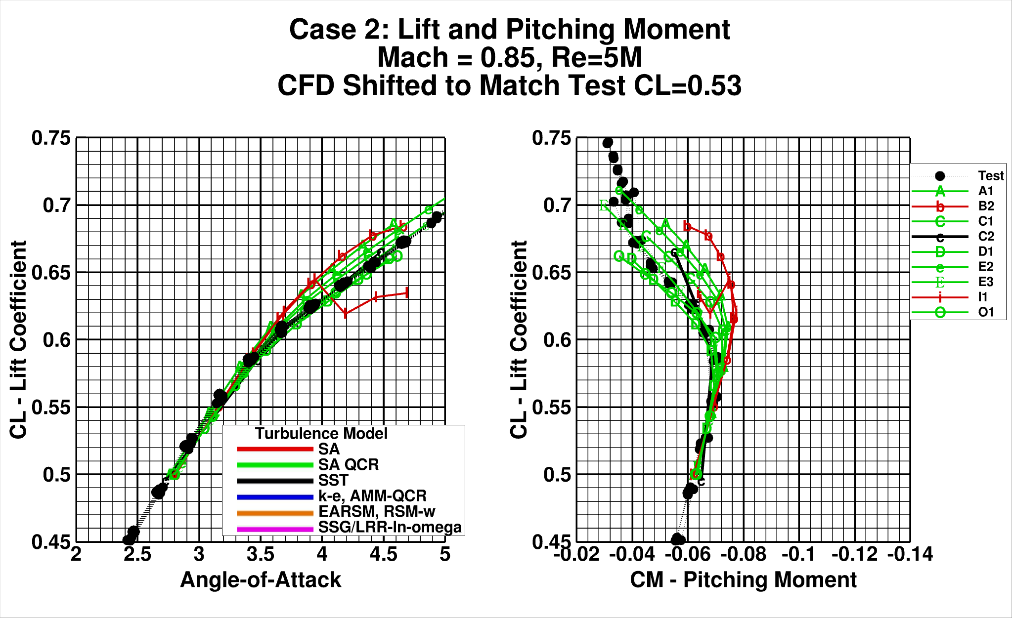

Slide 39
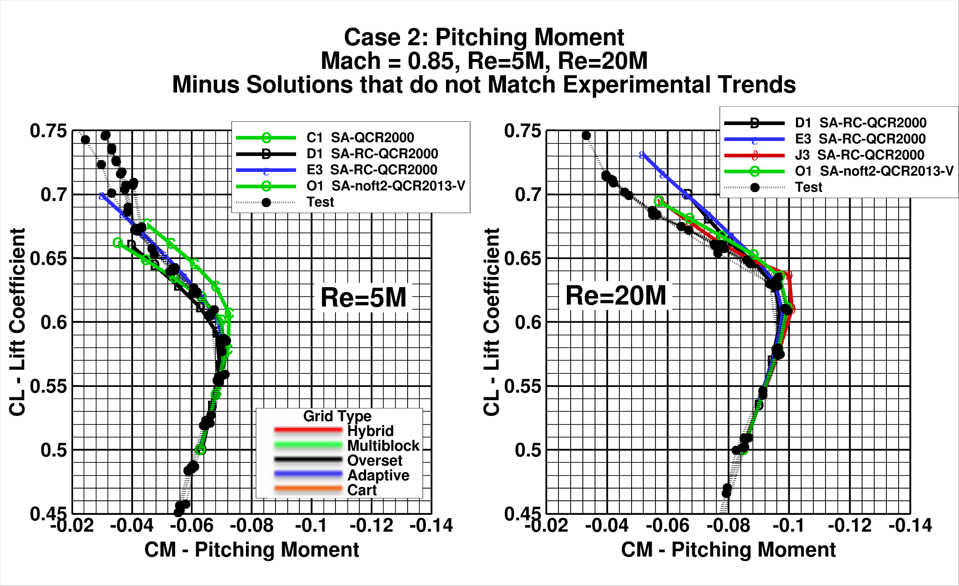

Slide 40
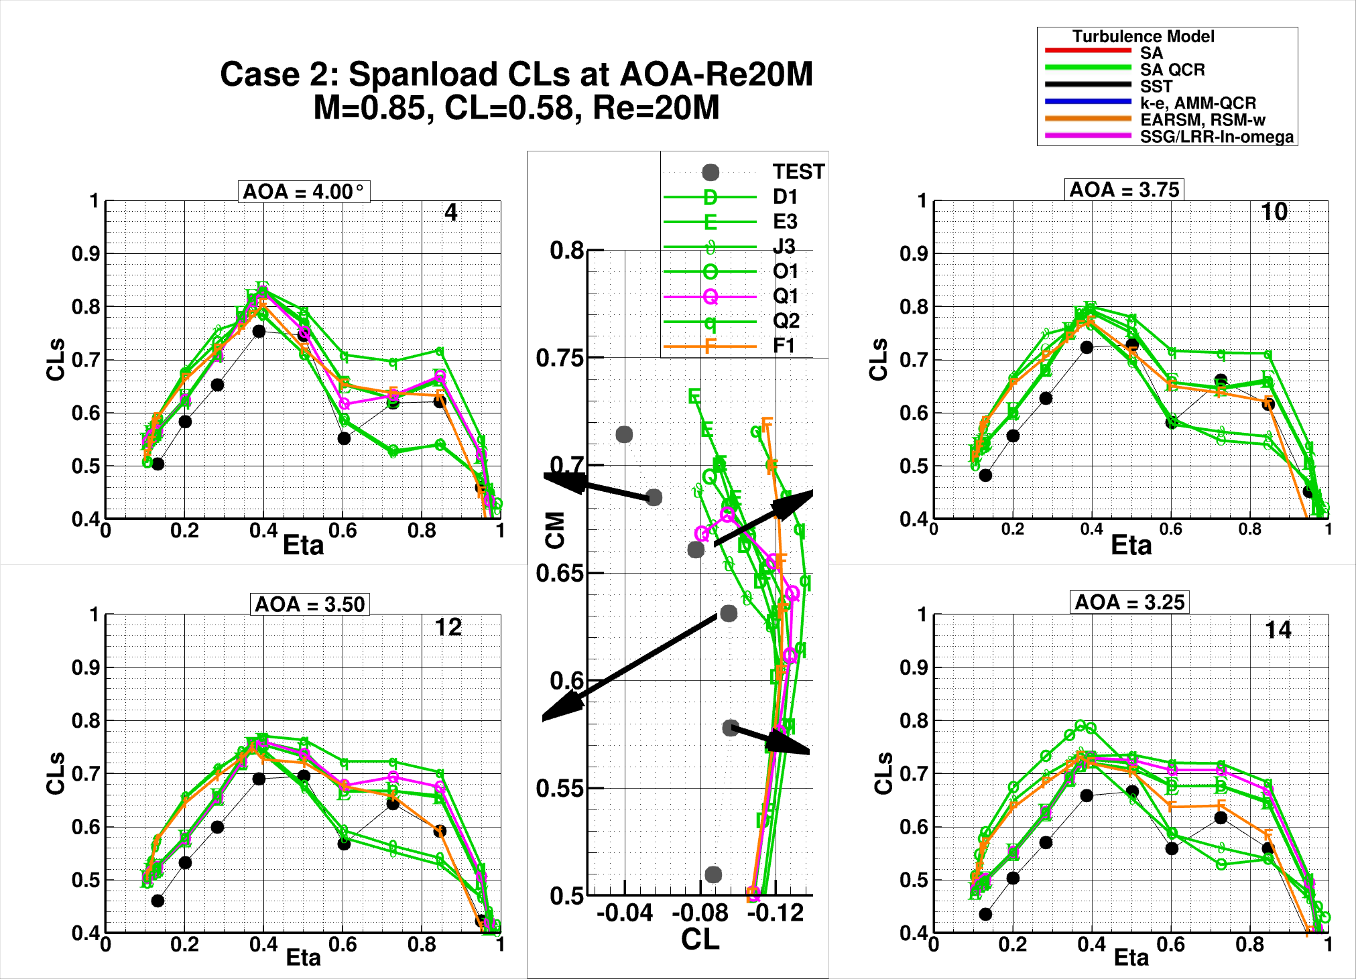

Slide 41
Case 2 - Observations
High angles of attack characterized by shock induced separation which significantly influences pitching moments.
No clear break-outs with grid type
Solutions that best matched pitching moment trends used SA-QCR turbulence model (but many outliers)
Pitching moment trend for all solutions
Tighter moment up to CL=0.58
Significant force and moment spread at α=4.25° ΔCL=0.05, ΔCM=0.043
Excessive aft-loading on outboard wing sections contributes to too negative section pitching moments and excessive section lift.

Slide 42
Outline:
Participant Data
Case 1: Grid Convergence Study
Case 2: Angle of Attack Sweep
Case 3: Reynolds Number Sweep
Case 4: Grid Adaptation
Case 5: Beyond RANS
Case 6: Coupled Aero-Structural Simulation
Observations/Issues

Slide 43
CRM Wing-Body Reynolds Number Sweep At Constant CL (Required): Flow conditions are: M = 0.85, CL = 0.50, medium grids;
Re = 5M, LoQ – R5 grid using 2.50-deg LoQ AE CRM geometry, Reference temperature = 100° F (Same LoQ R5 medium grid solution from Case 2b)
Re=20M, LoQ – R30 grid using 2.50-deg LoQ AE CRM geometry, Reference temperature = -250° F (Same LoQ R30 medium grid solution from Case 2a)
Re=20M, HiQ – R30 grid using 2.50-deg HiQ AE CRM geometry and R30grid, Reference temperature = -182° F
Re=30M, HiQ – R30 grid using 2.50-deg HiQ AE CRM geometry and R30grid, Reference temperature = -250° F

Slide 44
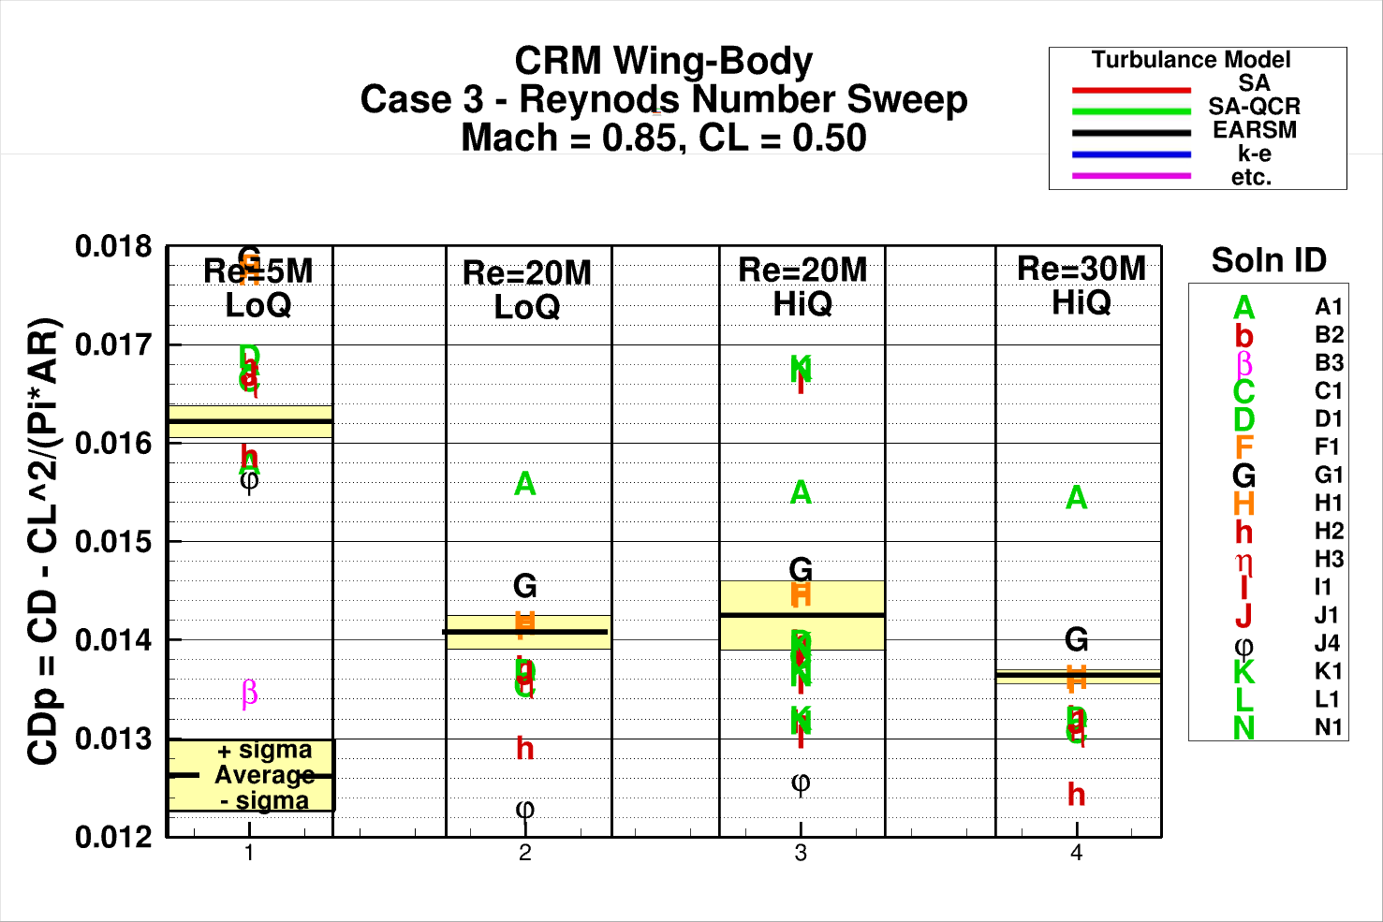

Slide 45
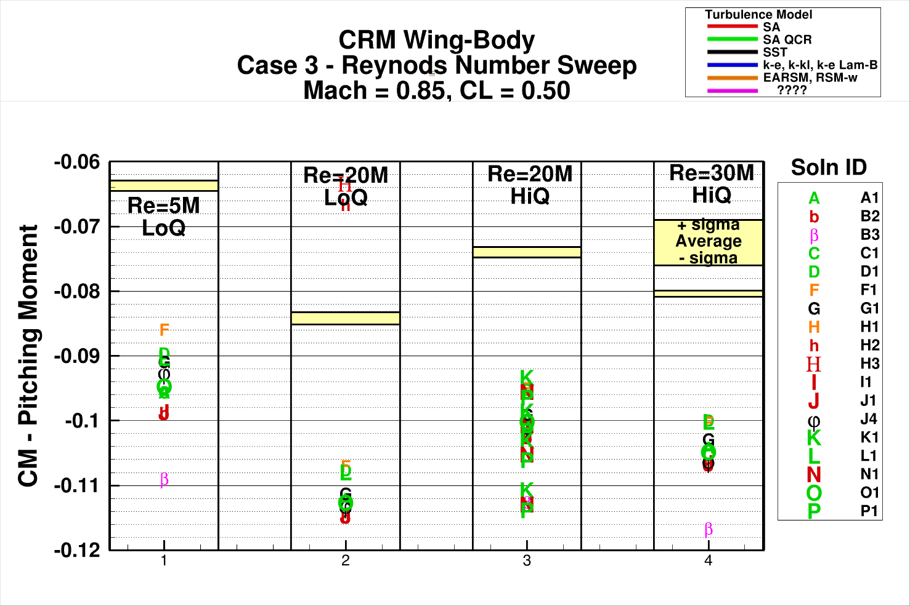

Slide 46
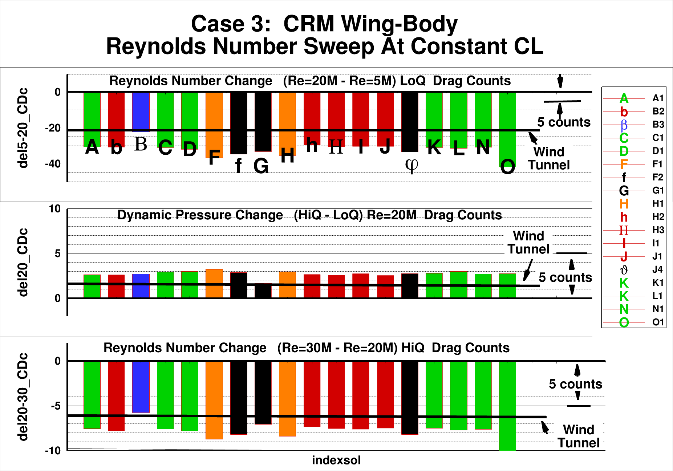

Slide 47
Case 3 - Observations
Drag trends with changes in Reynolds number and dynamic pressure are correctly predicted

Slide 48
Outline:
Participant Data
Case 1: Grid Convergence Study
Case 2: Angle of Attack Sweep
Case 3: Reynolds Number Sweep
Case 4: Grid Adaptation
Case 5: Beyond RANS
Case 6: Coupled Aero-Structural Simulation
Observations/Issues

Slide 49
Case 4: CRM WB Grid Adaptation:
NASA Common Research Model, Wing-Body
Mach=0.85, C_{L}=0.500±0.001
Chord Reynolds Number: 20x10^{6,} 5x10⁶ Optional
Solution Adapted Grid
Angle of Attack sweep – (preferred priority):
CL = 0.58 3.00-deg LoQ AE CRM geometry
α = 4.00° 4.00-deg LoQ AE CRM geometry
α = 3.50° 3.50-deg LoQ AE CRM geometry
α = 4.25° 4.25-deg LoQ AE CRM geometry
α = 3.25° 3.25-deg LoQ AE CRM geometry
α = 3.75° 3.75-deg LoQ AE CRM geometry

Slide 50
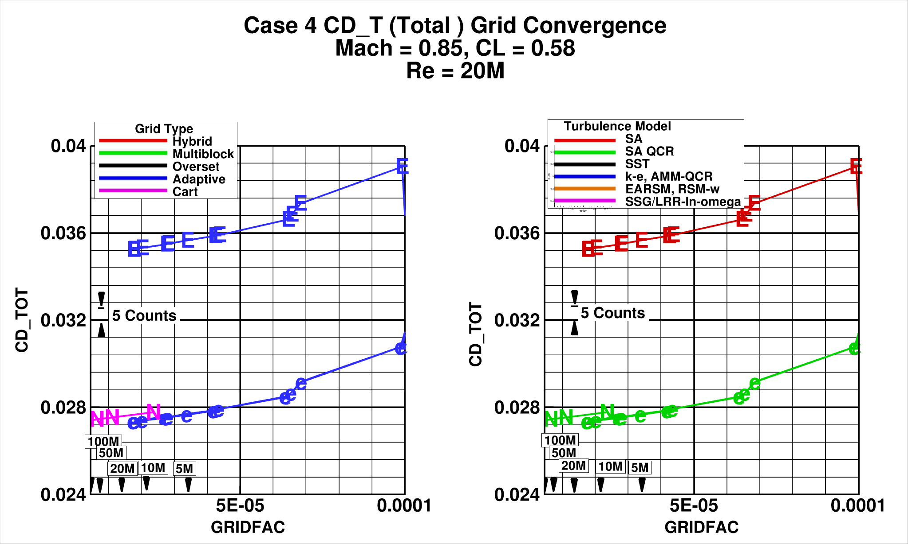

Slide 51
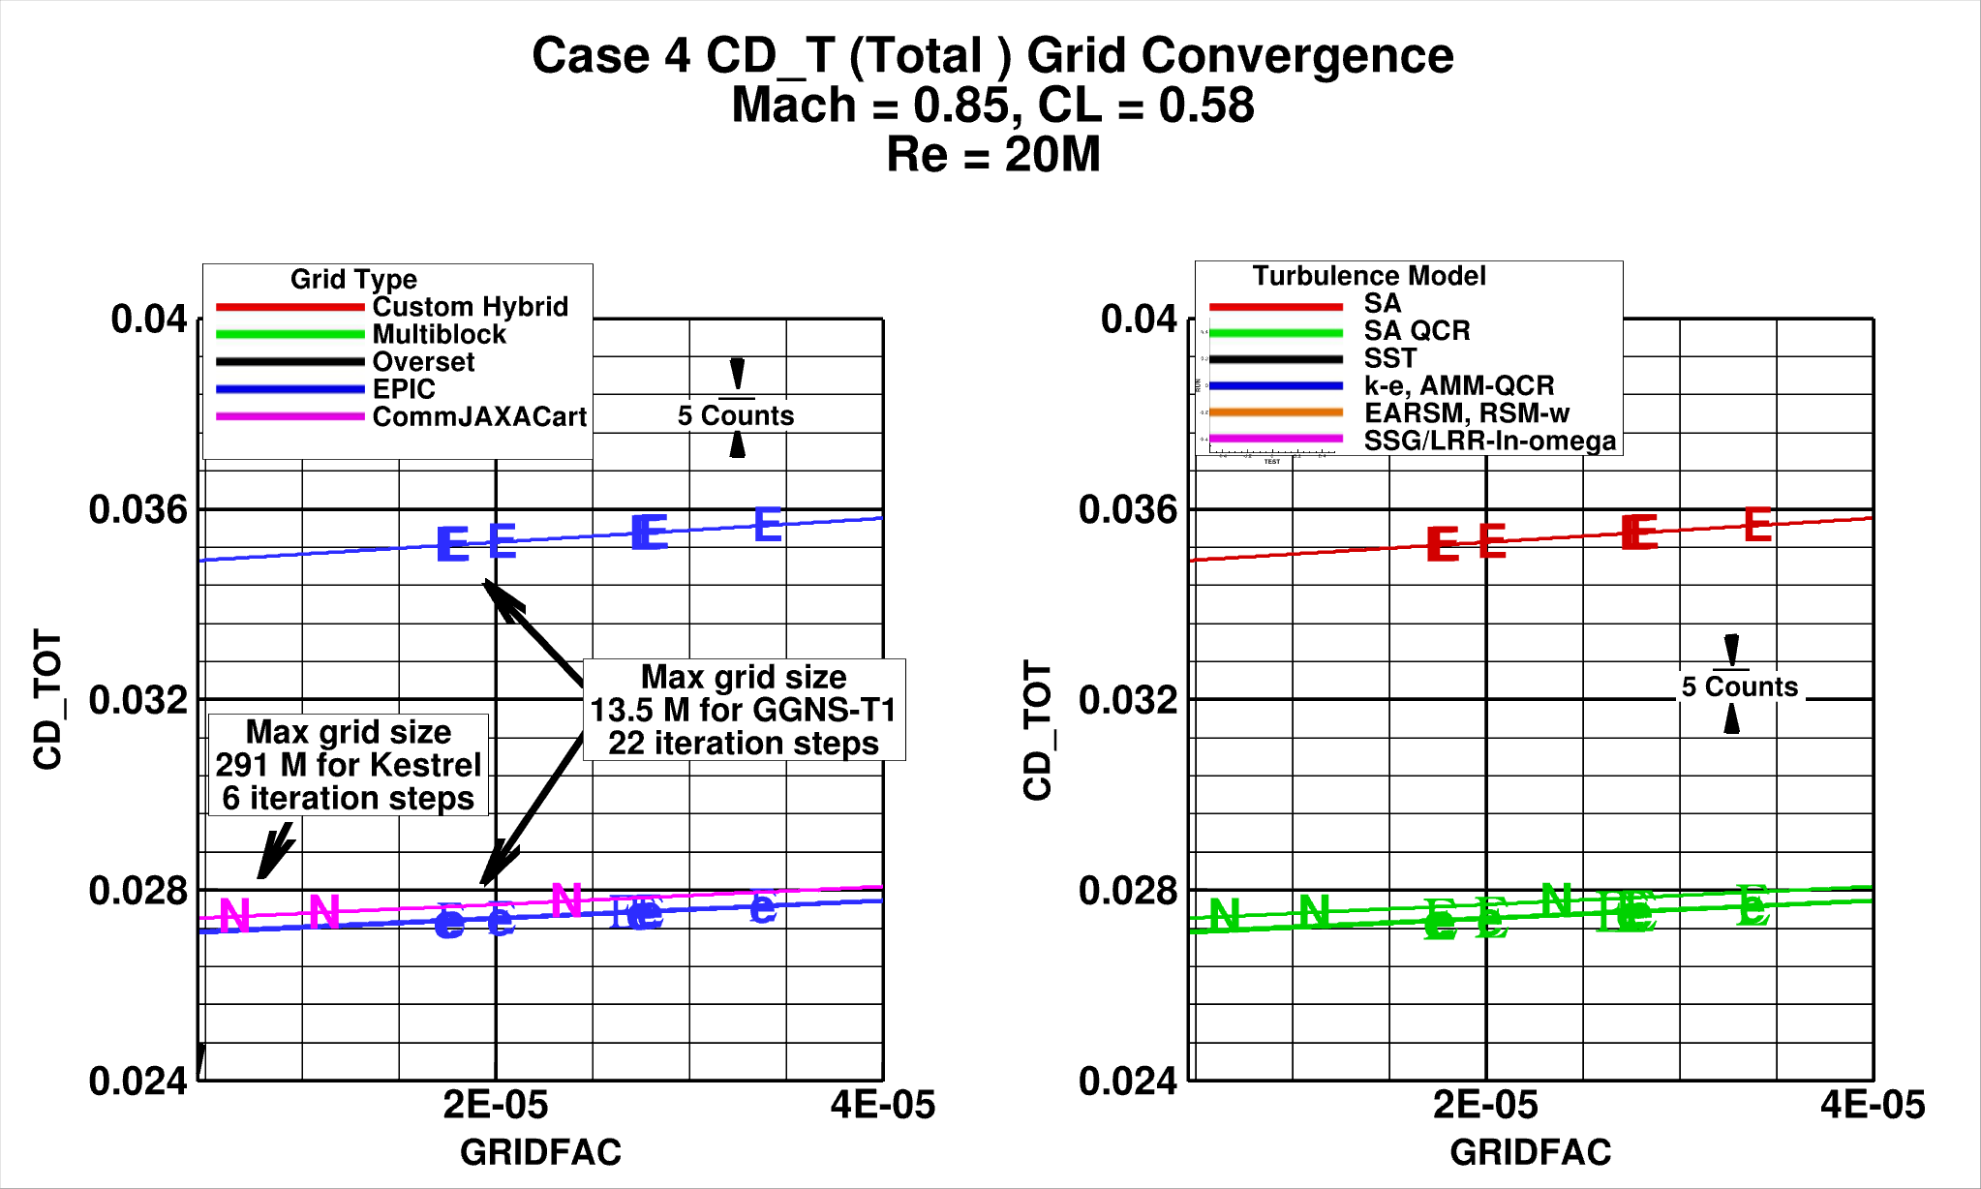

Slide 52
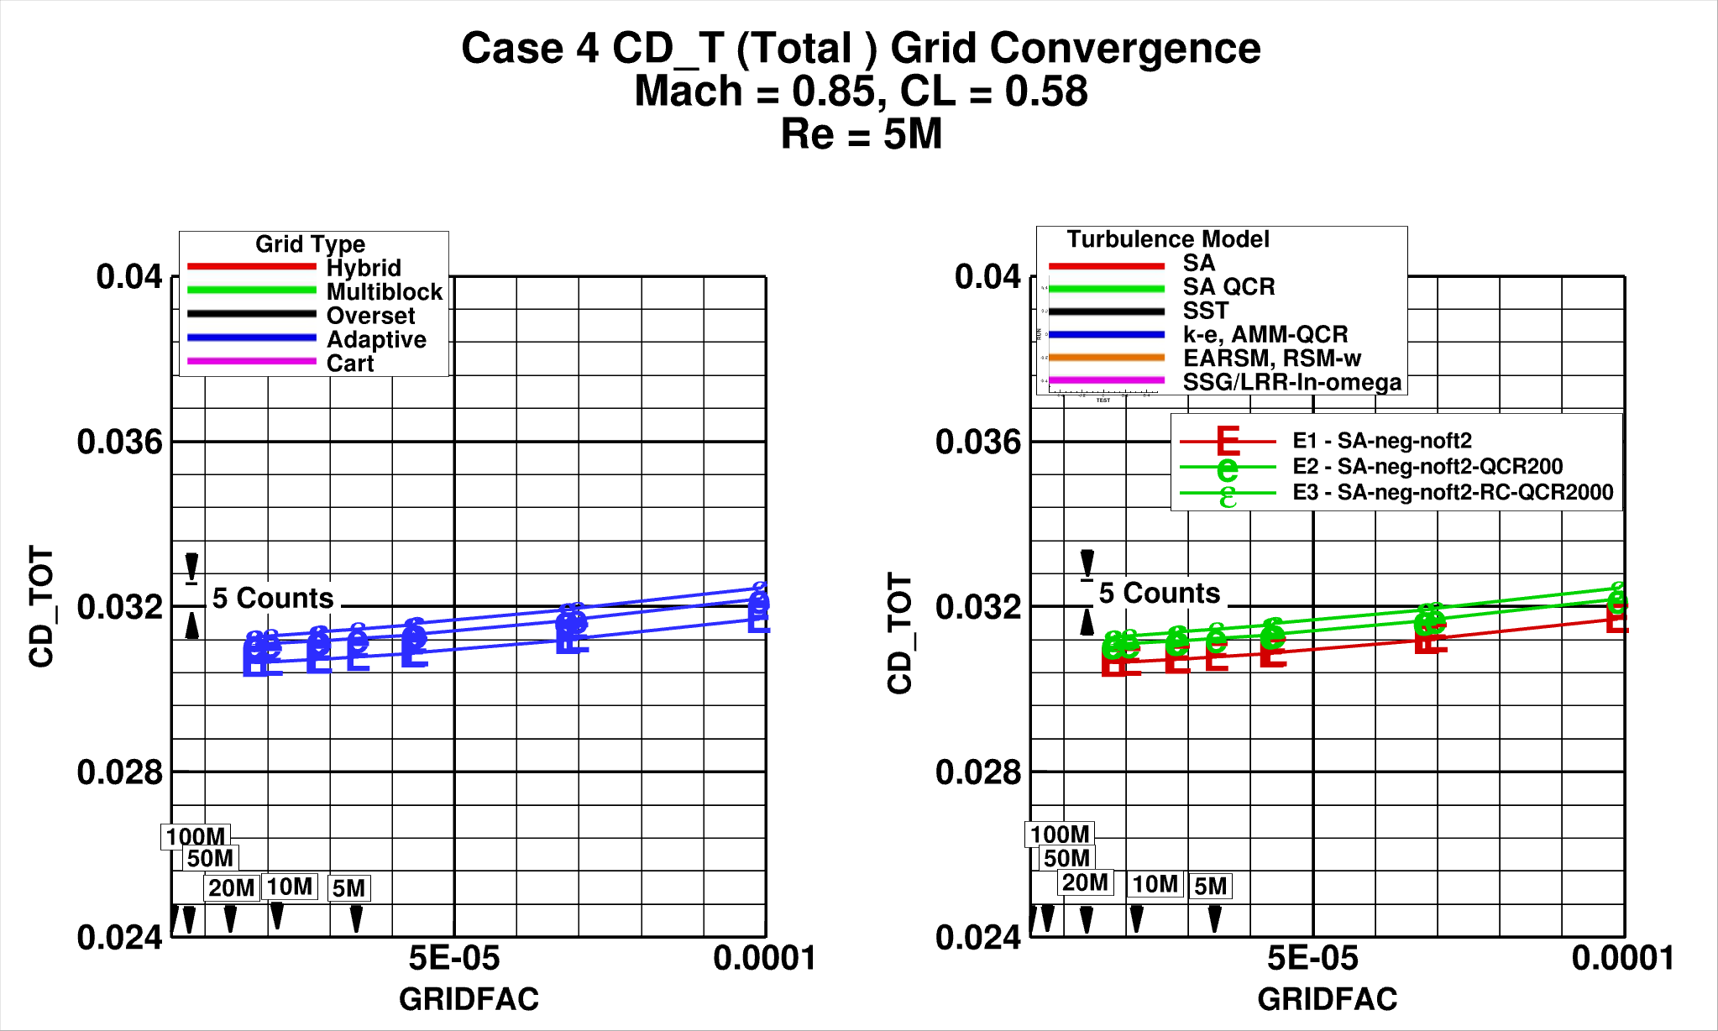

Slide 53
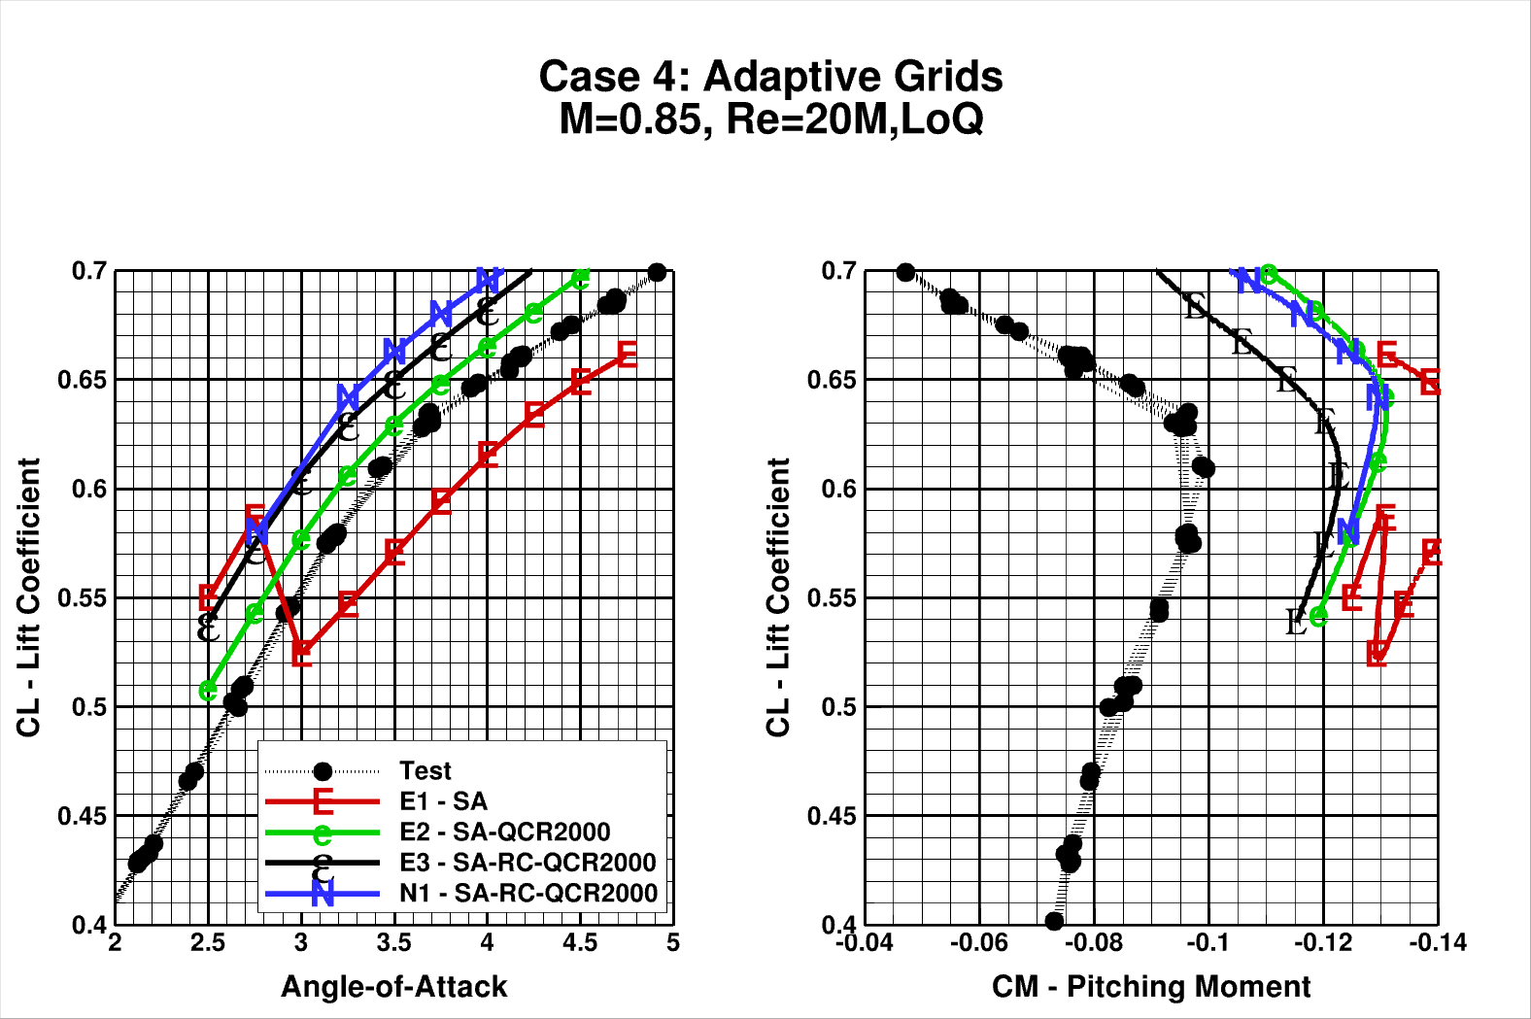

Slide 54
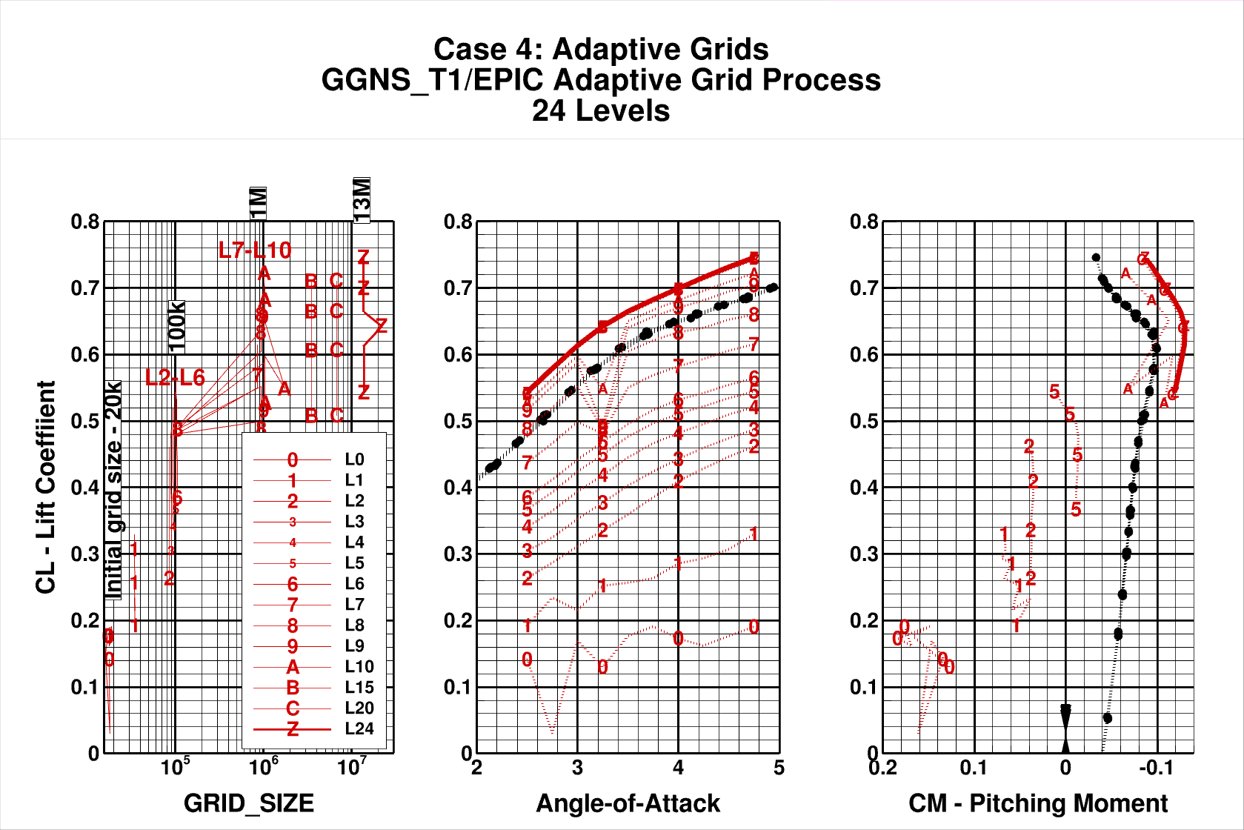

Slide 55
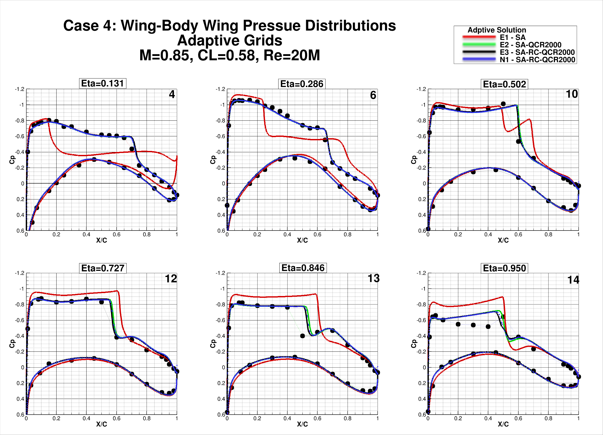
X

Slide 56
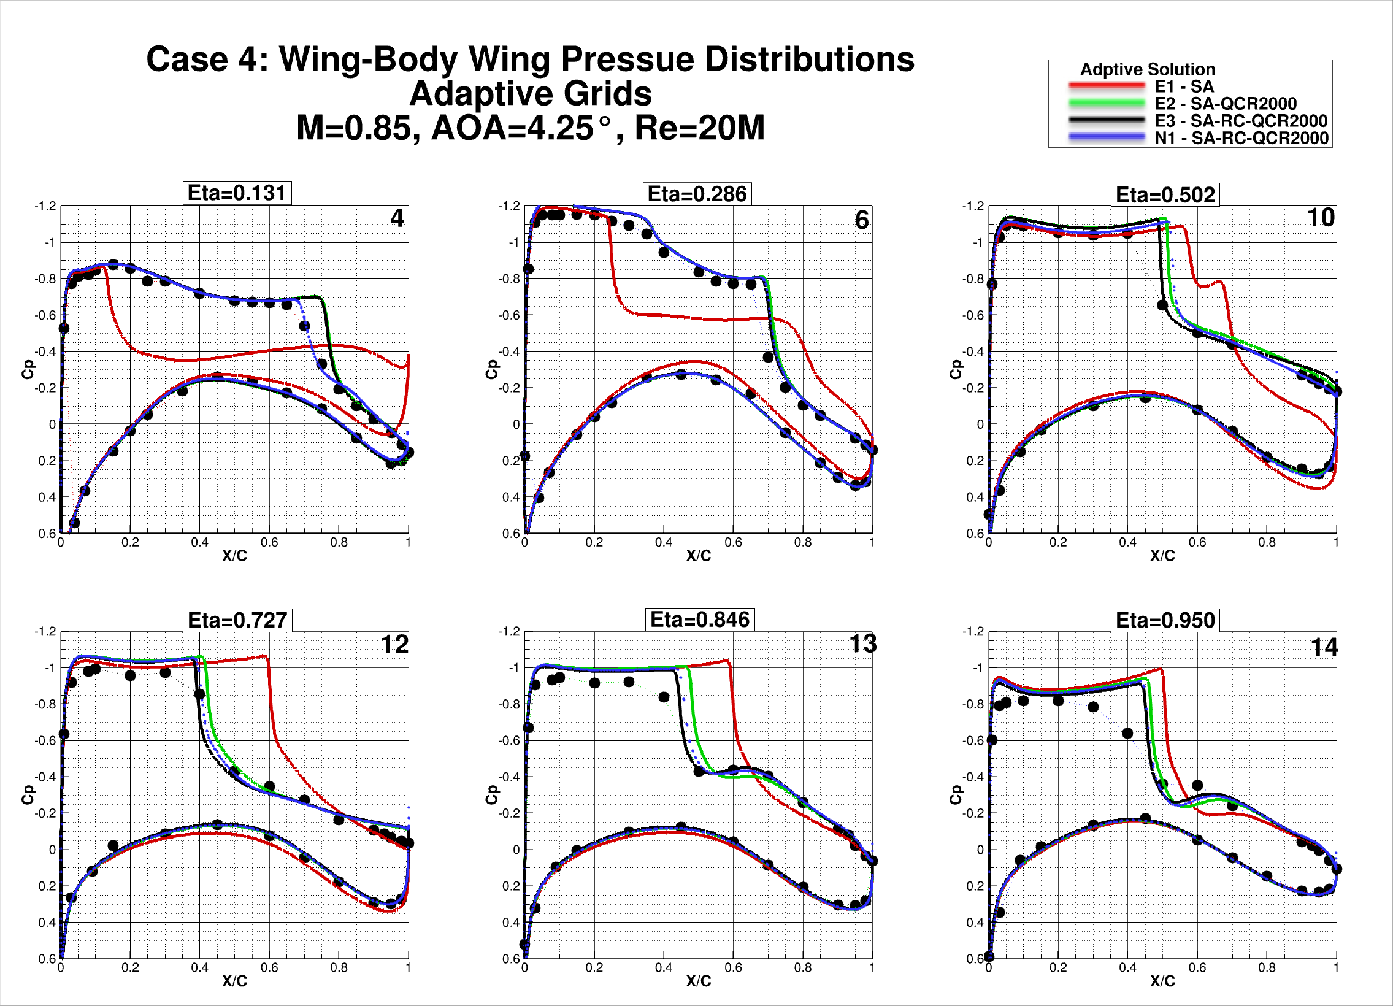

Slide 57
Case 4 - Observations
Little benefit is seen for adaptive grid solutions compared to fixed grid solutions for this simple wing-body geometry.
Decades have been spent developing and validating gridding guidelines for these “simple” geometries and expected flow features.
The benefit of adaptive grid solutions is to be seen for geometries/flow features for which there is little prior experience.

Slide 58
Outline:
Participant Data
Case 1: Grid Convergence Study
Case 2: Angle of Attack Sweep
Case 3: Reynolds Number Sweep
Case 4: Grid Adaptation
Case 5: Beyond RANS
Case 6: Coupled Aero-Structural Simulation
Observations/Issues

Slide 59
Case 5: Beyond RANS [Optional]:
Solution technologies beyond steady RANS such as URANS, DDES, WMLES, Lattice Boltzmann, etc. Flow conditions are: M = 0.85; Re = 20 million; Reference temperature = -250°F. Single solution at CL = 0.58 or alpha sweep. Baseline grids not provided
Angle of Attack sweep – (preferred priority):
CL = 0.58 3.00-deg LoQ AE CRM geometry
α = 4.00° 4.00-deg LoQ AE CRM geometry
α = 3.50° 3.50-deg LoQ AE CRM geometry
α = 4.25° 4.25-deg LoQ AE CRM geometry
α = 3.25° 3.25-deg LoQ AE CRM geometry
α = 3.75° 3.75-deg LoQ AE CRM geometry
(Please order results in Angle-of-Attack monotonic order)

Slide 60
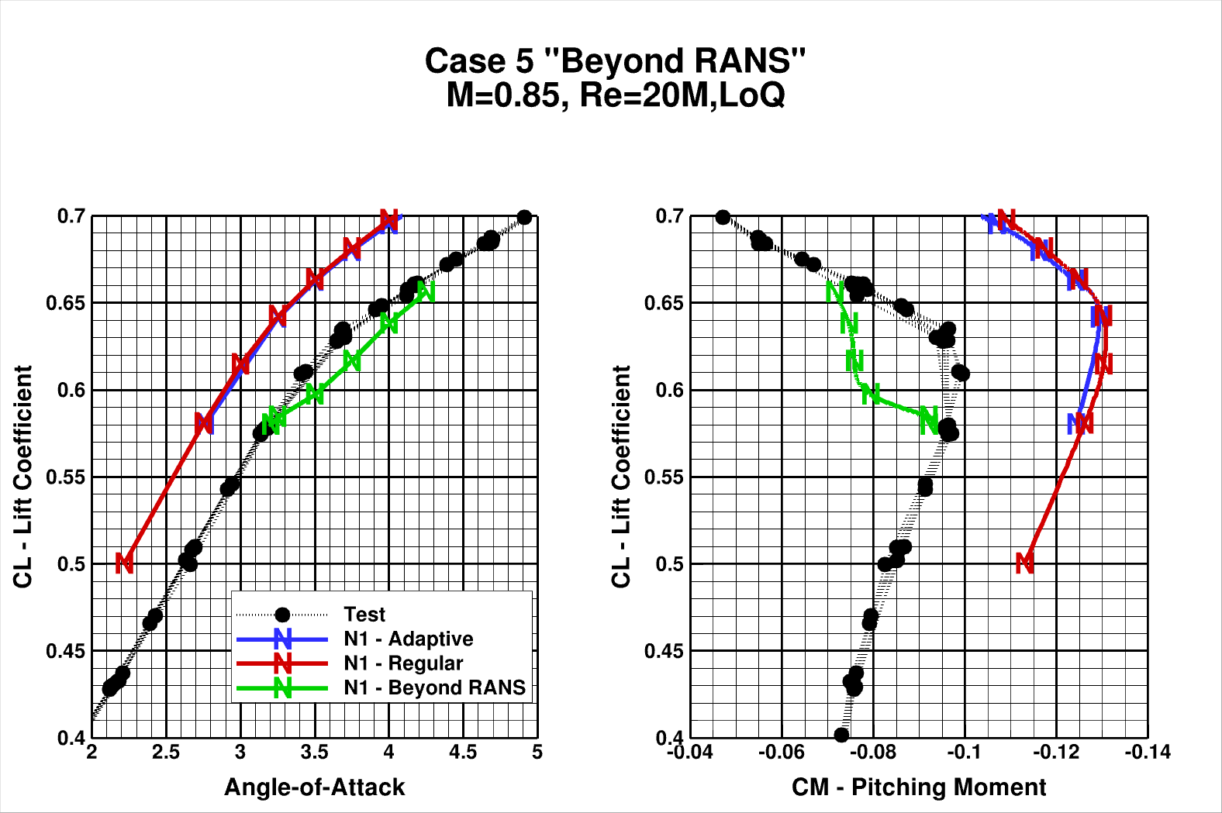

Slide 61
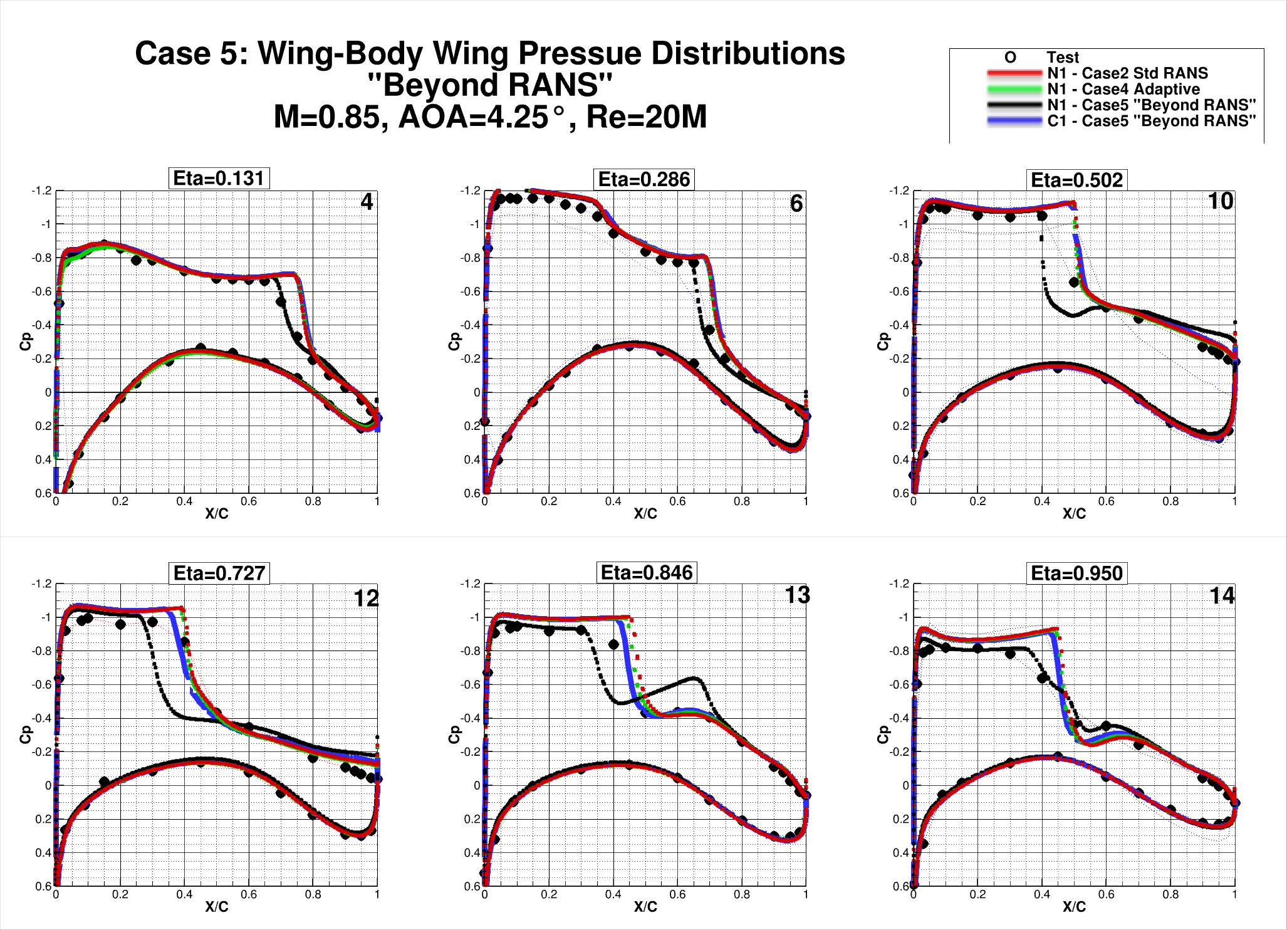

Slide 62
Case 5 - Observations
Difficult to make any meaningful observations from limited number of solutions and time available to examine results.

Slide 63
Outline:
Participant Data
Case 1: Grid Convergence Study
Case 2: Angle of Attack Sweep
Case 3: Reynolds Number Sweep
Case 4: Grid Adaptation
Case 5: Beyond RANS
Case 6: Coupled Aero-Structural Simulation
Observations/Issues

Slide 64
Case 6: CRM WB Coupled Aero-Structural Simulation :
NASA Common Research Model, Wing-Body
Mach=0.85, C_{L}=0.500±0.001
Chord Reynolds Number: 20x10^{6,} 5x10⁶ Optional
Fixed lift condition for the CRM Wing-Body coupled with computational structural analysis
Structural FEM from the CRM Website
Angle of Attack sweep – (preferred priority):
CL = 0.58 3.00-deg LoQ AE CRM geometry
a = 4.00° 4.00-deg LoQ AE CRM geometry
a = 3.50° 3.50-deg LoQ AE CRM geometry
a = 4.25° 4.25-deg LoQ AE CRM geometry
a = 3.25° 3.25-deg LoQ AE CRM geometry
a = 3.75° 3.75-deg LoQ AE CRM geometry

Slide 65
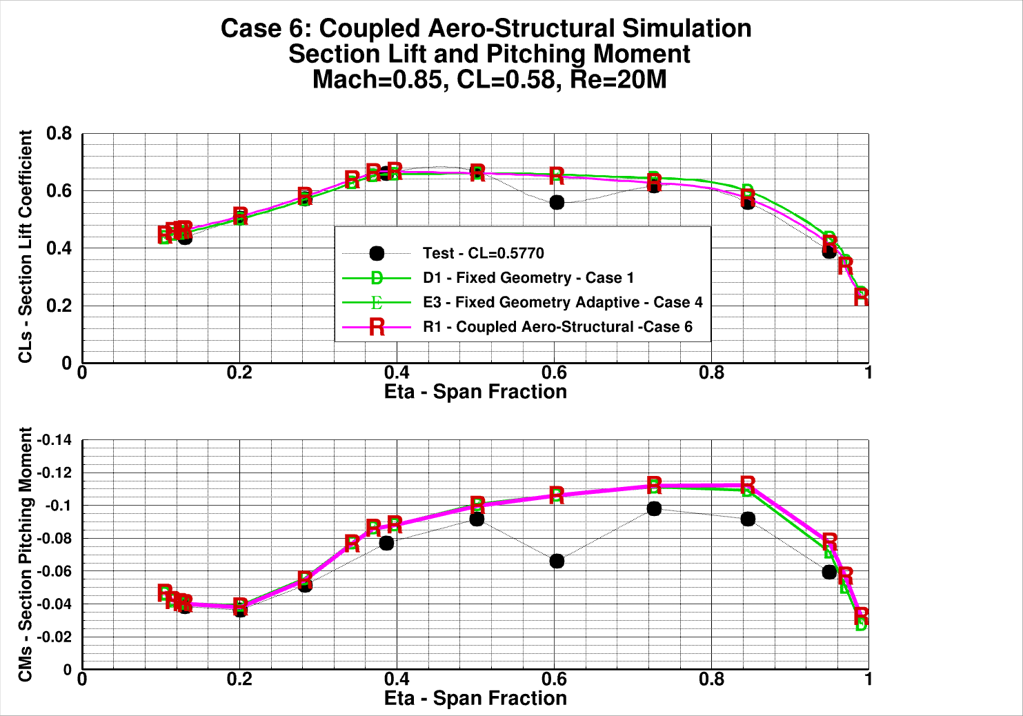

Slide 66
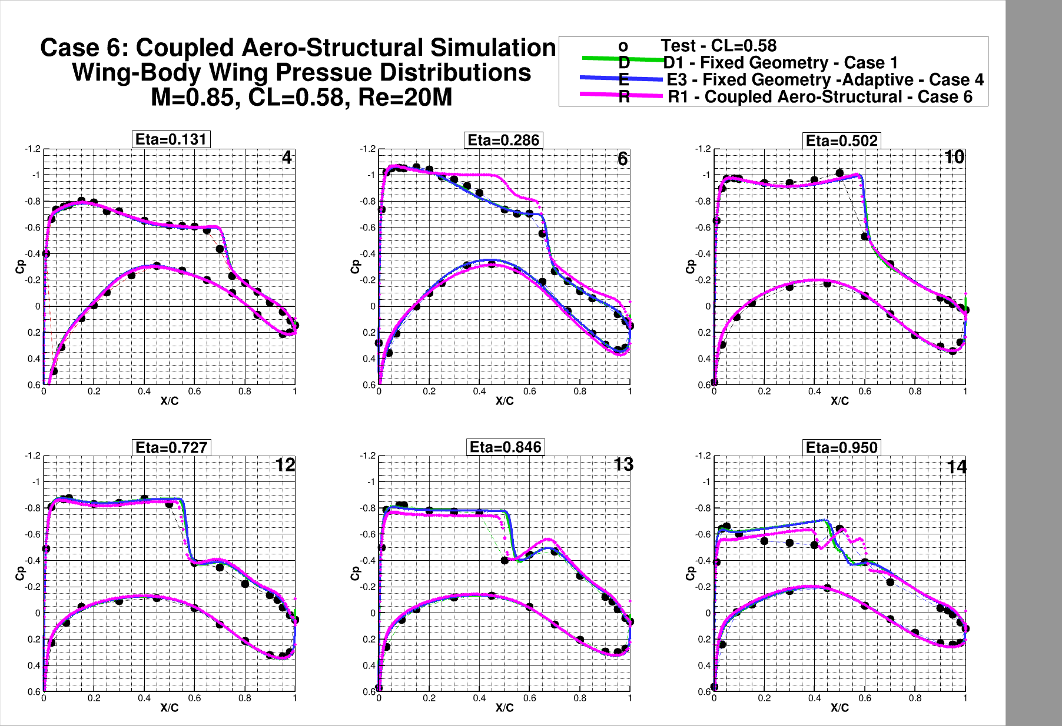

Slide 67
Case 6 - Observations
Difficult to make any meaningful observations from limited number of solutions and time available to examine results.

Slide 68
Outline:
Participant Data
Case 1: Grid Convergence Study
Case 2: Angle of Attack Sweep
Case 3: Reynolds Number Sweep
Case 4: Grid Adaptation
Case 5: Beyond RANS
Case 6: Coupled Aero-Structural Simulation
Observations/Issues

Slide 69
General Observations and Comments:
Very successful workshop. Thank You!
30 data submittals, many with parametric variations in grid type and/or turbulence model
Still more variation than desired
Some improvement from DPW6: We are getting better
Drag comparisons to wind tunnel generally favorable but too much variation of pitching moment at higher angles of attack – we need to better understand the interaction of grid, solver, turbulence model
A new CFD study of the CRM wind tunnel mounting system effects is needed, and should include the effects on the CRM Wing-Body, and Wing-Body-Tail configurations.

Slide 70
Further detailed experimental measurements that adequately capture the flow separation and unsteadiness on these types of configurations at “off-design” conditions are needed. Hard to make CFD progress without adequate experimental data for guidance and validation.
These solution sets and experimental data represent a gold mine of information to further the knowledge of CFD and aerodynamics – GREAT PROJECTS FOR MASTERS STDENTS.
For detailed analyses of DPW4, 5, and 6 featuring the NASA CRM - Tinoco, Edward N., “An Evaluation and Recommendations for Further CFD Research Based on the NASA Common Research Model (CRM) Analysis from the AIAA Drag Prediction Workshop (DPW) Series,” NASA/CR-2019-220284

Slide 71
Grid Convergence?
Richardson Extrapolation:
Standard 2nd order least squares fit
For 2nd order codes, should be linear vs. Grid_Factor = N^{-2/3}
Y-intercept estimates theoretical infinite resolution (continuum) result

Slide 72
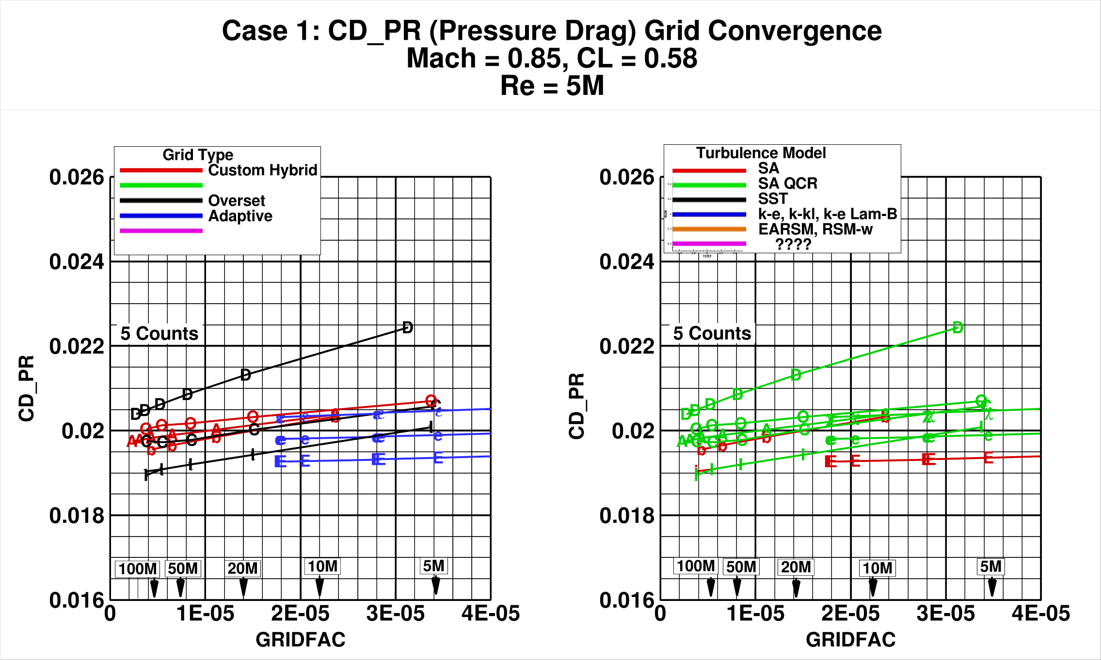

Slide 73
